Slide 1
(Musa’s) Lab meeting
Tsunghan 20230630

Slide 2
Points
MicroC
Searching for lncRNA near IL1RN
IsoSeq (if we have time)

Slide 3
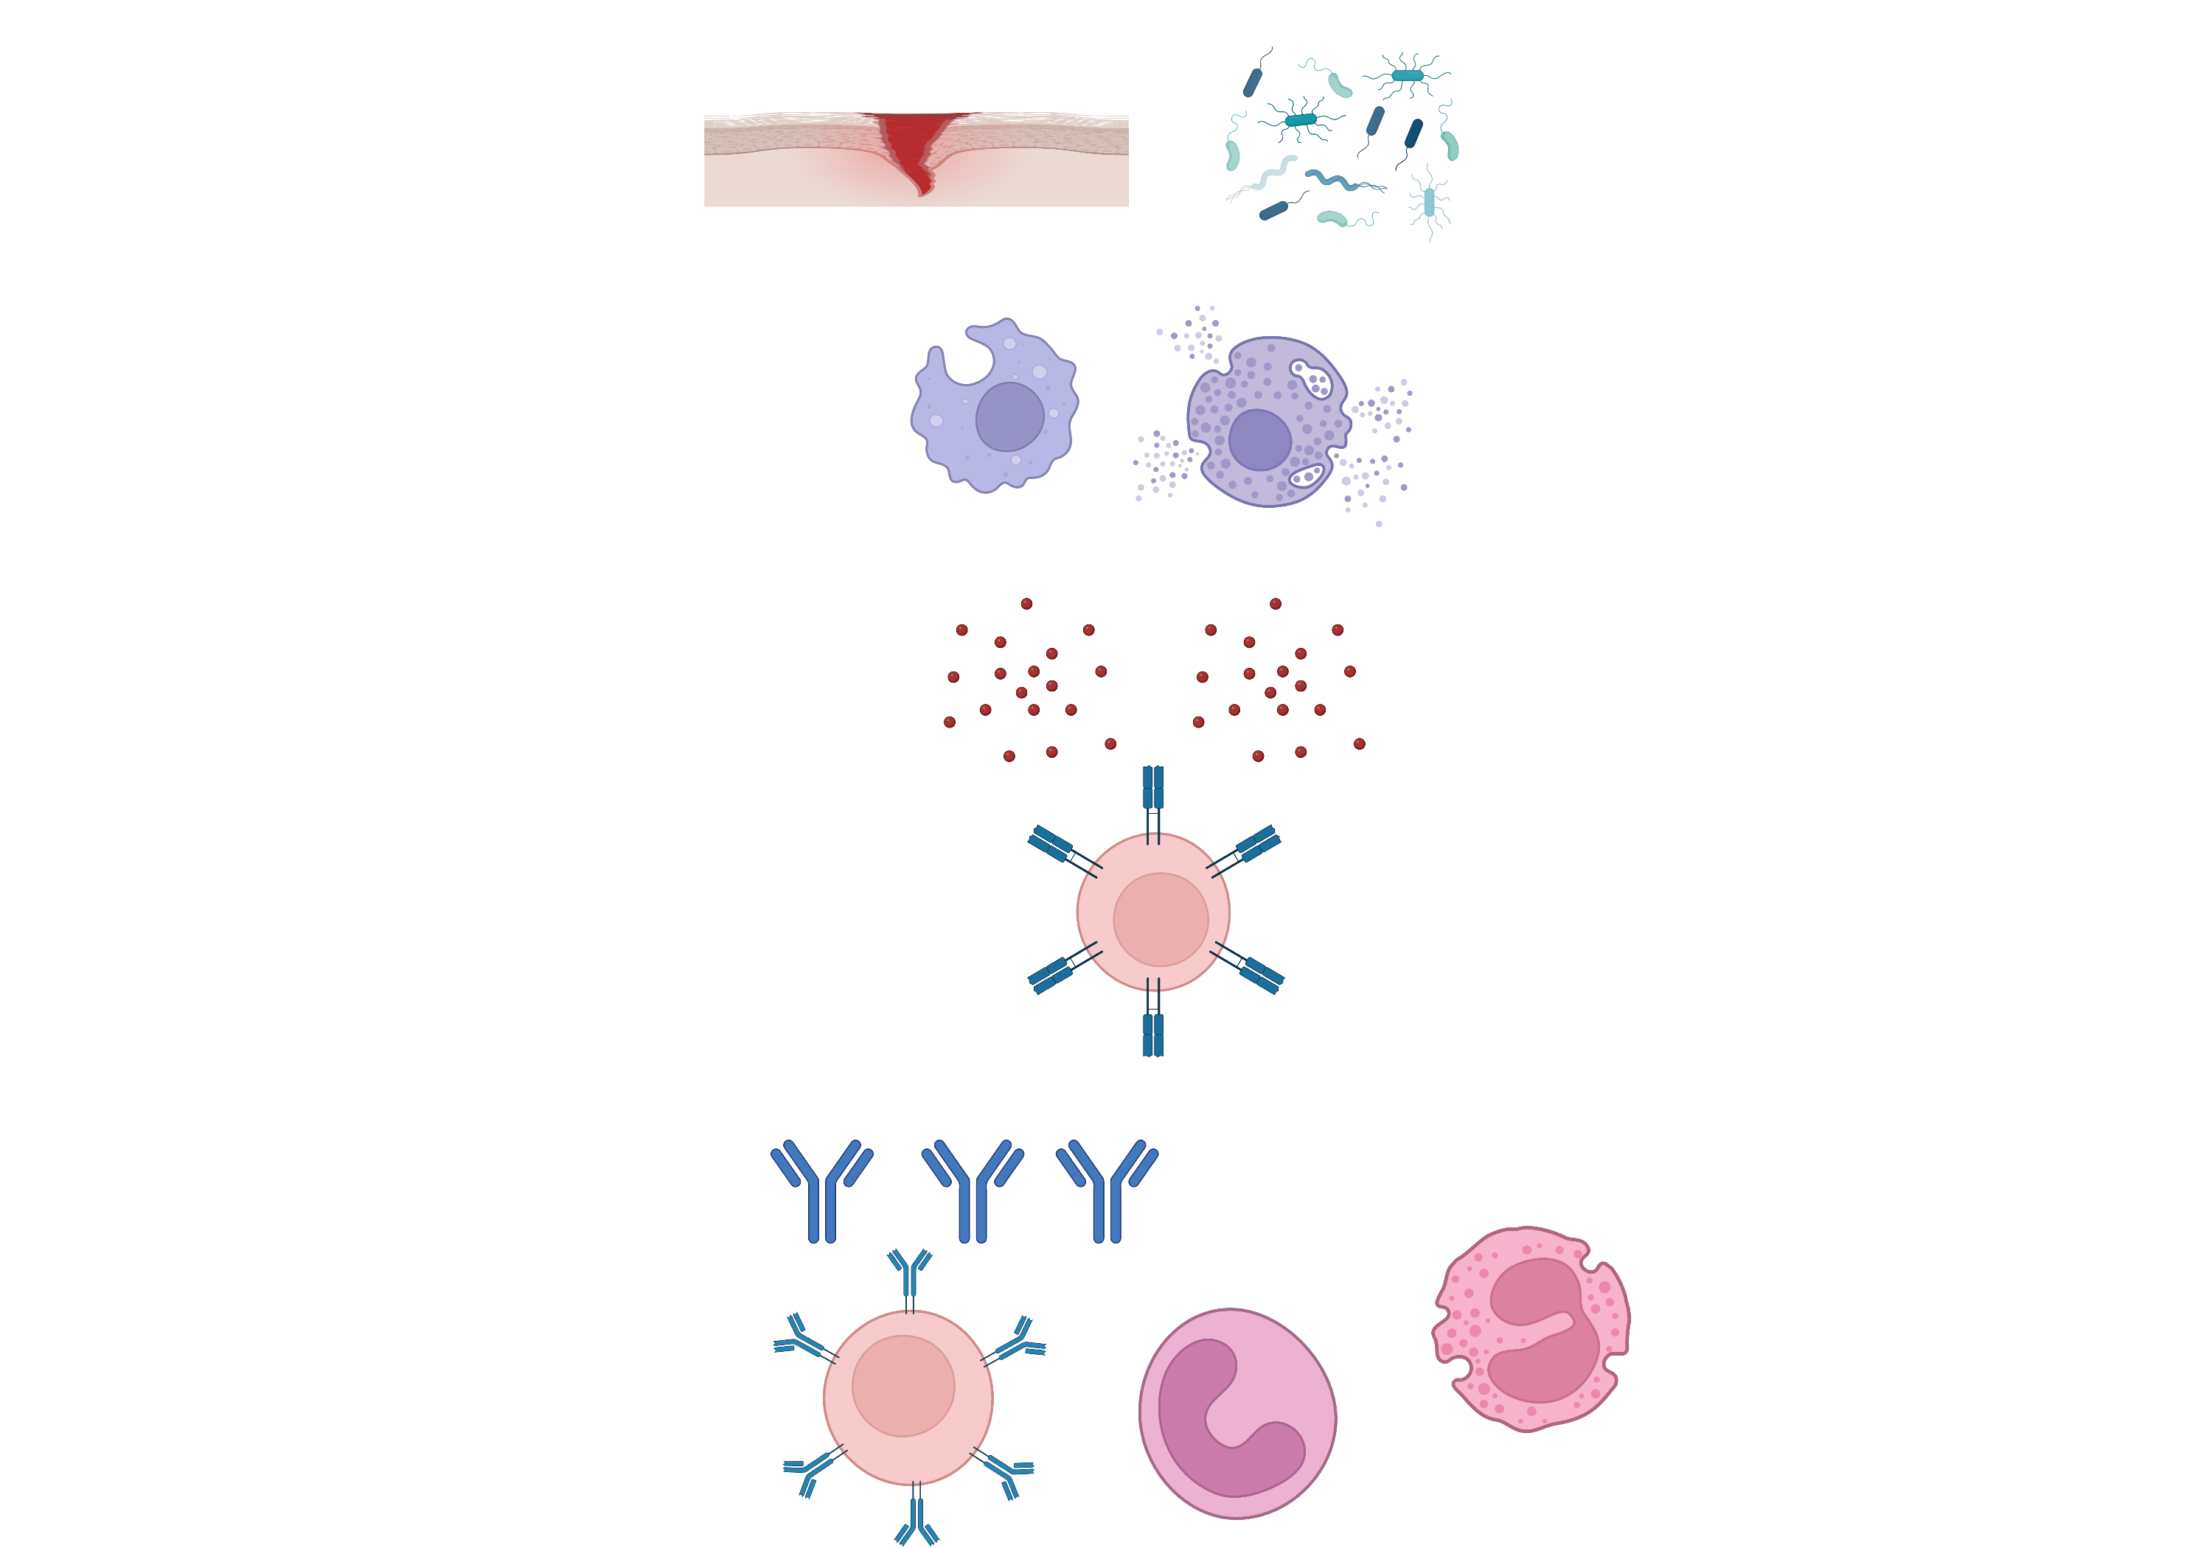
Inflammation
IL-1β
Inflammatory cytokines
Wound healing
Neutralizing microbial toxins
Removing microbes
PMN
B cells

Slide 4


Cytokine | Woking range
IL-1β | 1-5 pg/ml
IL-6 | >20 pg/ml
IL-18 | 10000-20000 pg/ml
IFN-g | 100-1000 pg/ml
IL-1β is the apex cytokine
Notes:
One molecule of IL-1b can activate one molecule of receptor of cells.

Slide 5
IL-1β / Th17: uncontrolled inflammation
IL-1β
Th17 -> pathogenic Th17 (with IL-23, via STAT3)
PMN
B cells
Notes:
IL-1B, IL6, IL-23 are added together to generate pathogenic Th17 cells in lab.

Slide 6
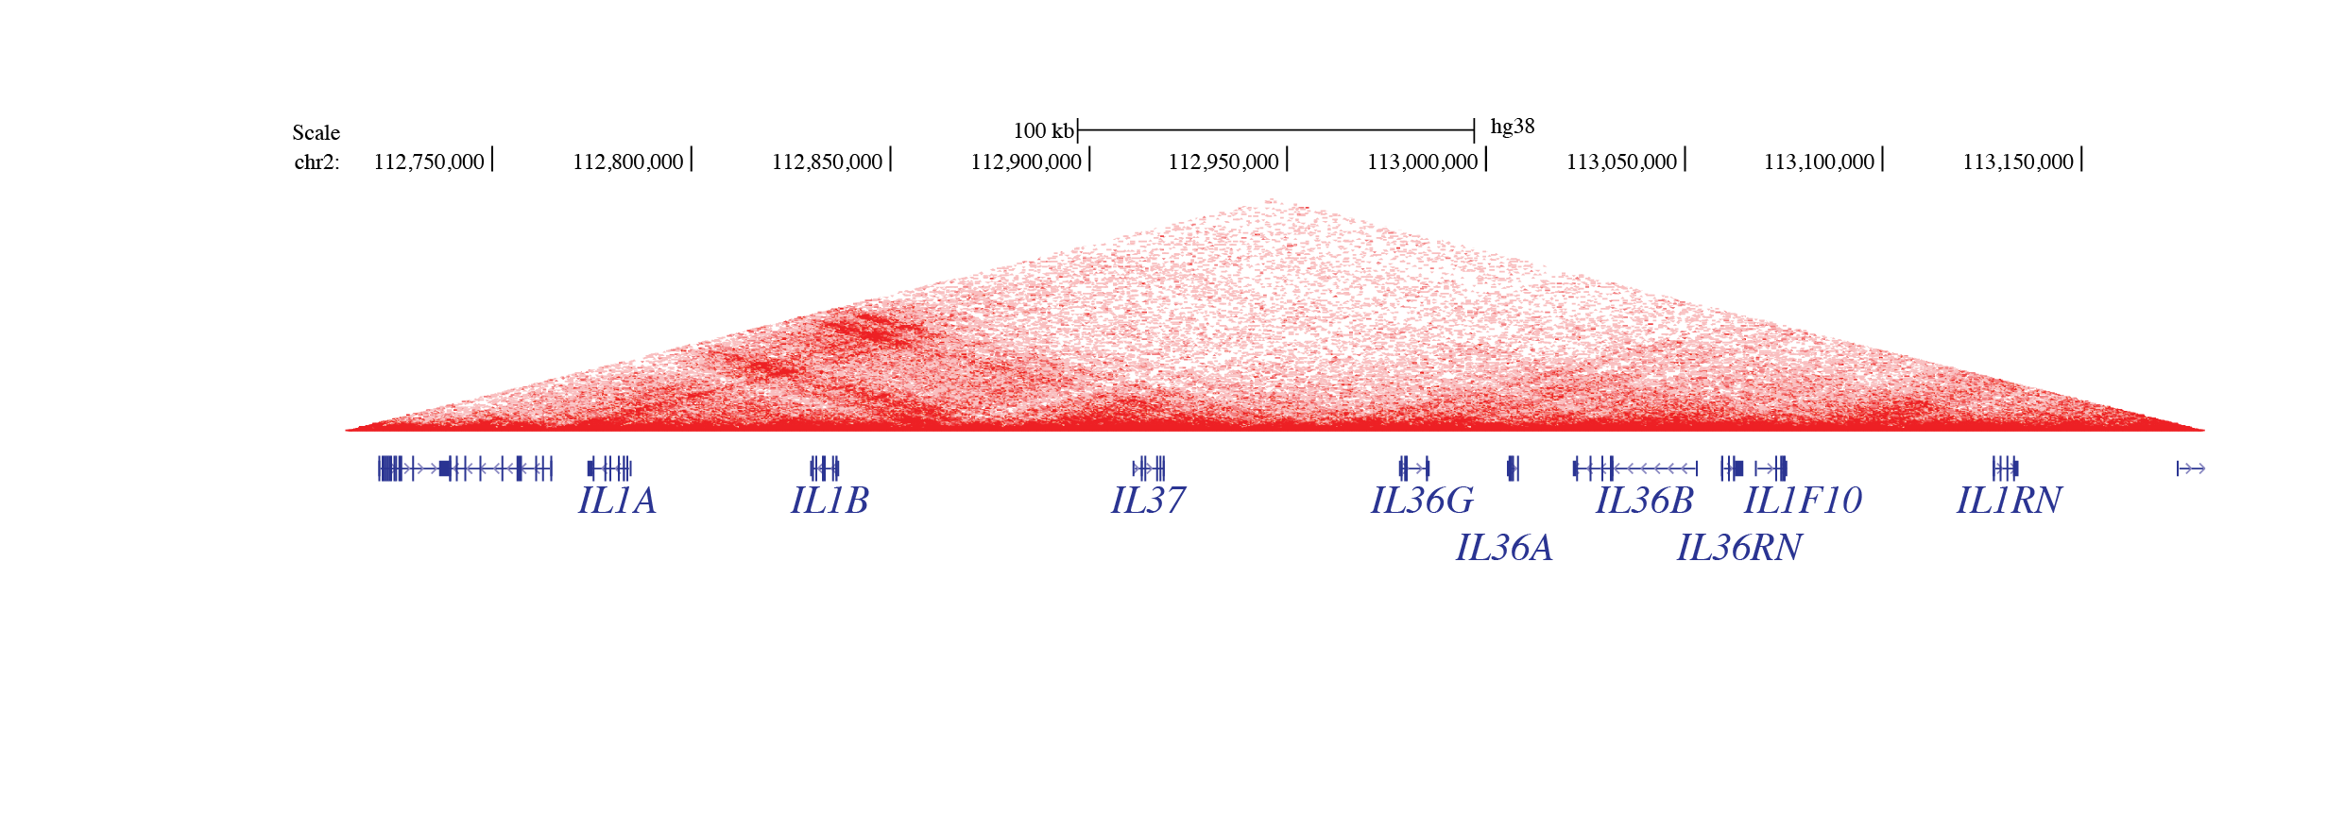
Both IL37 and IL1RN encode molecules inhibiting IL1B-mediated inflammation

Slide 7
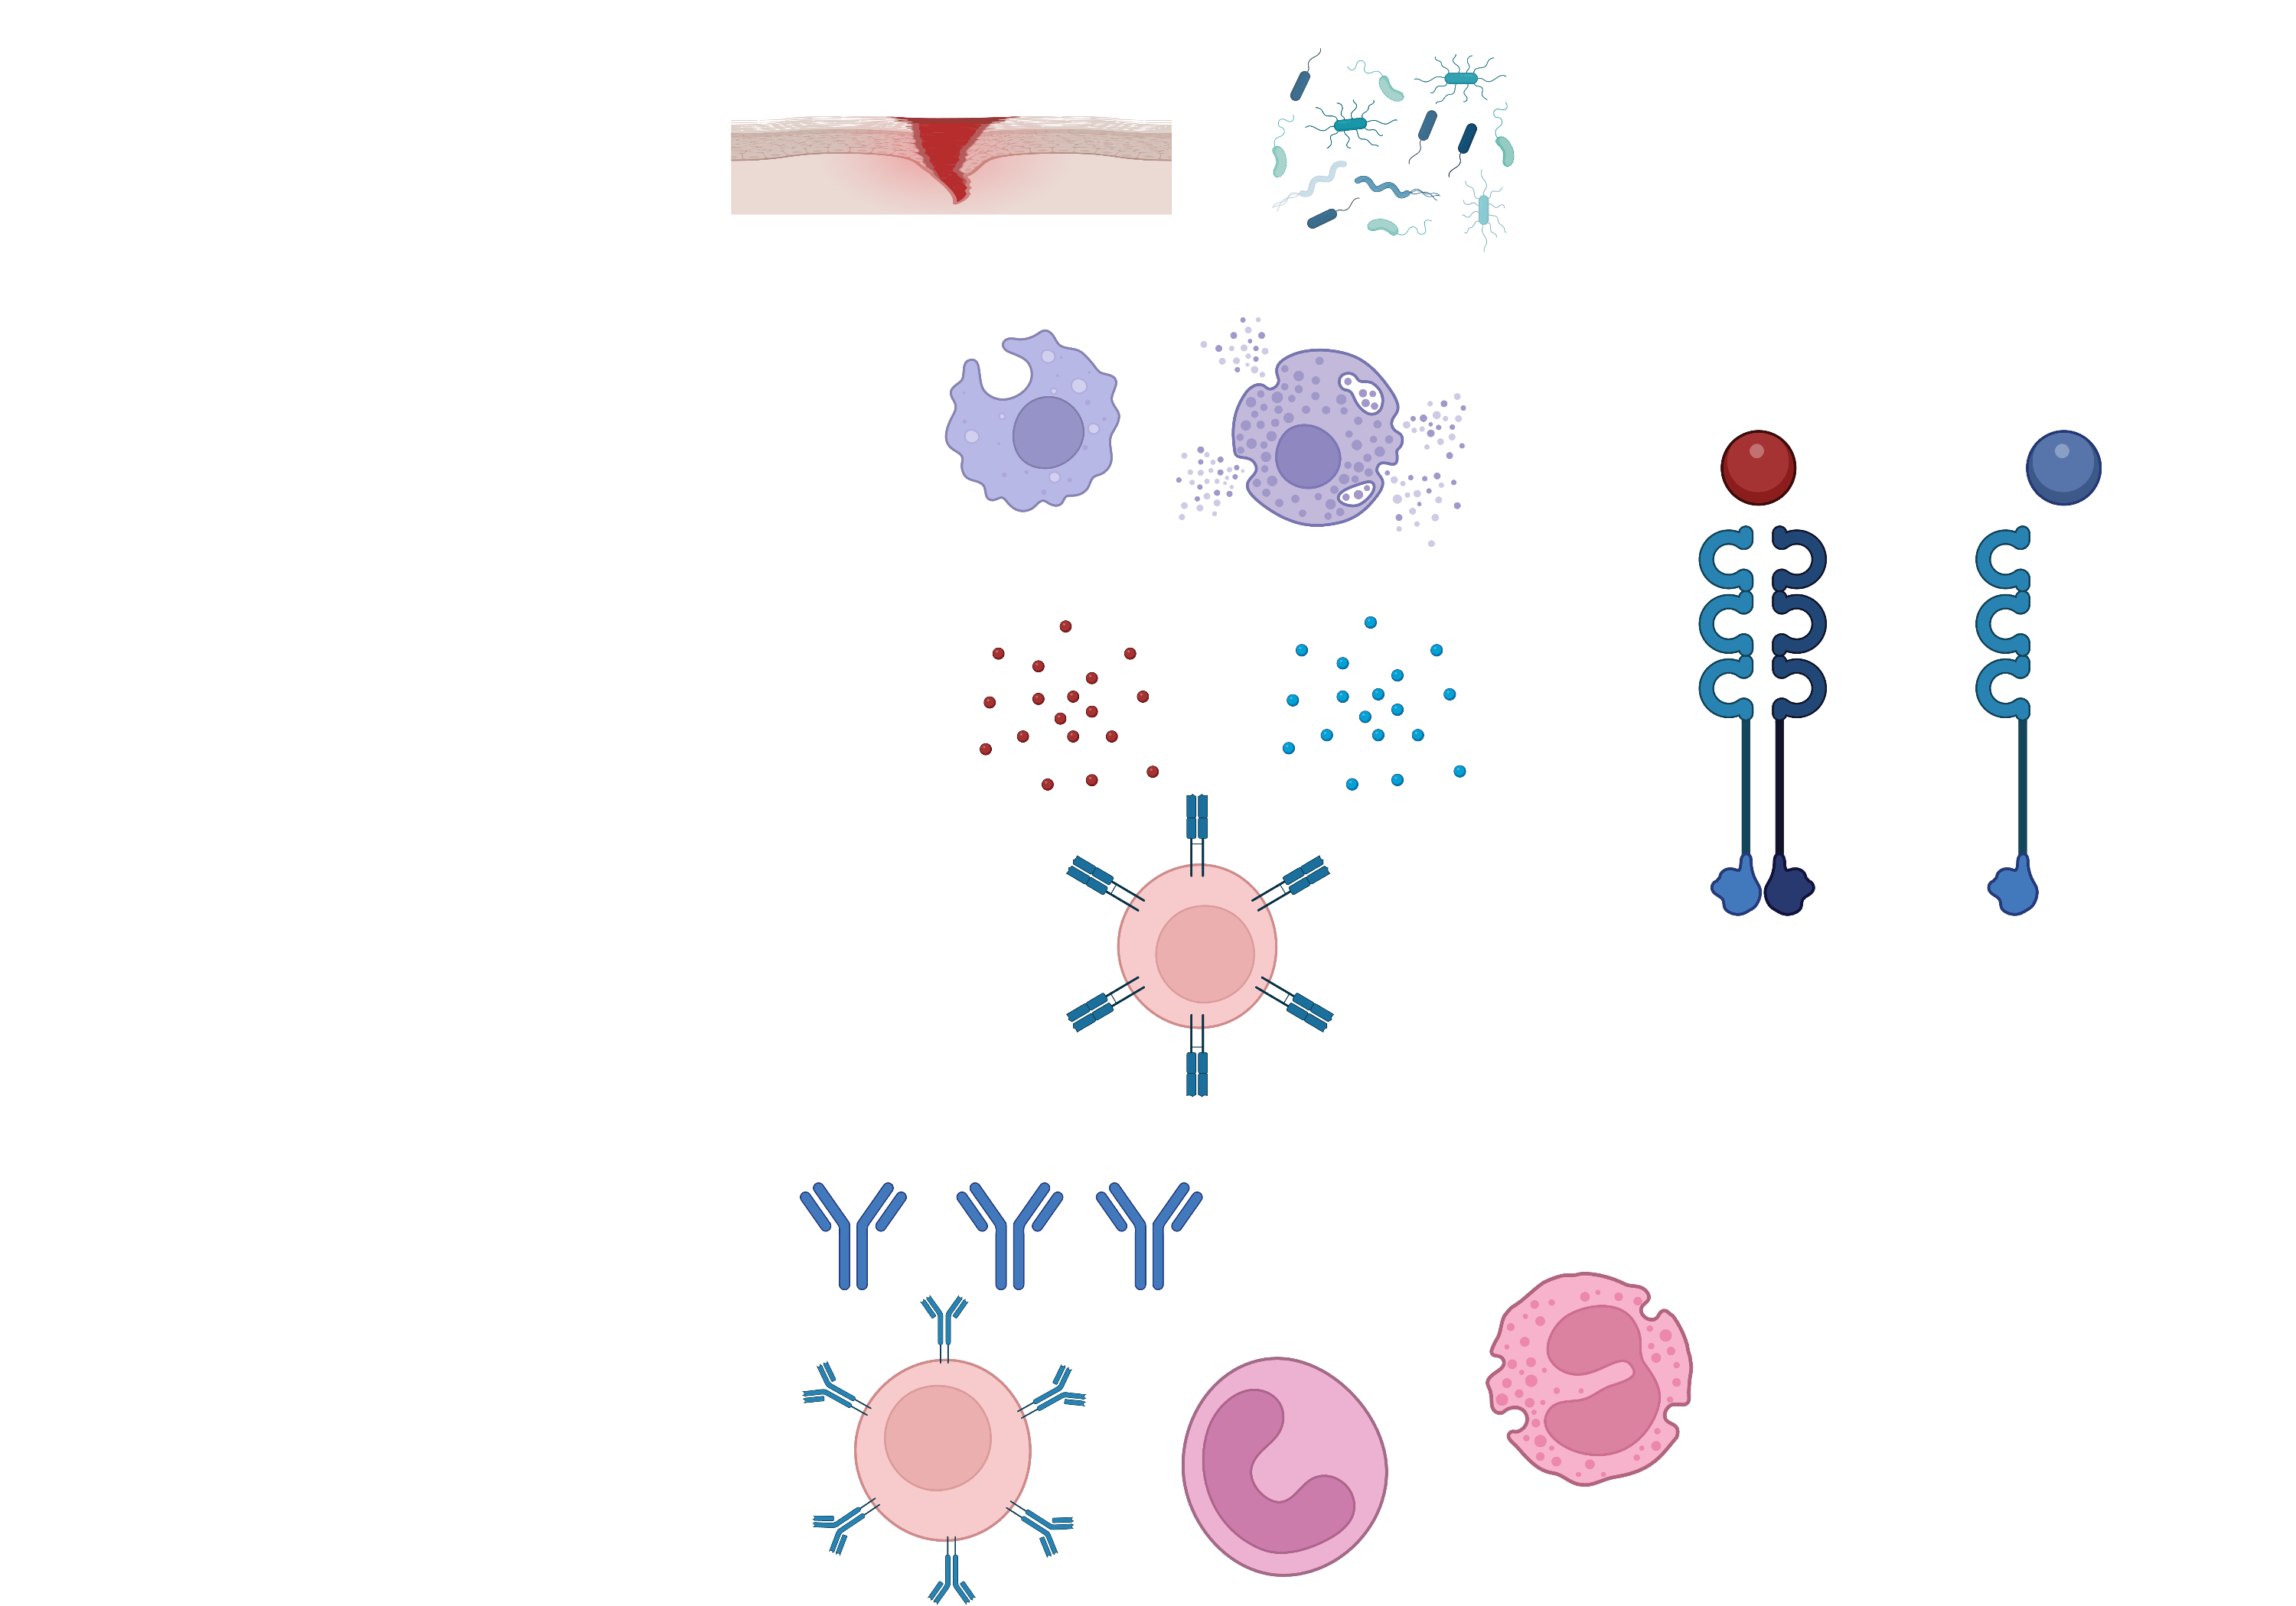
IL1RN (Interleukin 1 receptor antagonist) is the endogenous inhibitor of IL-1β
IL-1β
IL-1RN
signal
No signal
PMN
B cells
Notes:
IL1 receptor complex: IL1R (IL1R1) and IL1Rap (IL1R3).

Slide 8
IL-1RN can further activate the Treg program
IL-1RN
Th17 -> Treg (FOXP3)
No signal
IL-10
PMN
B cells

Slide 9
Identifying the expression and epigenetic marker profile of IL1B and IL1RN

Slide 10
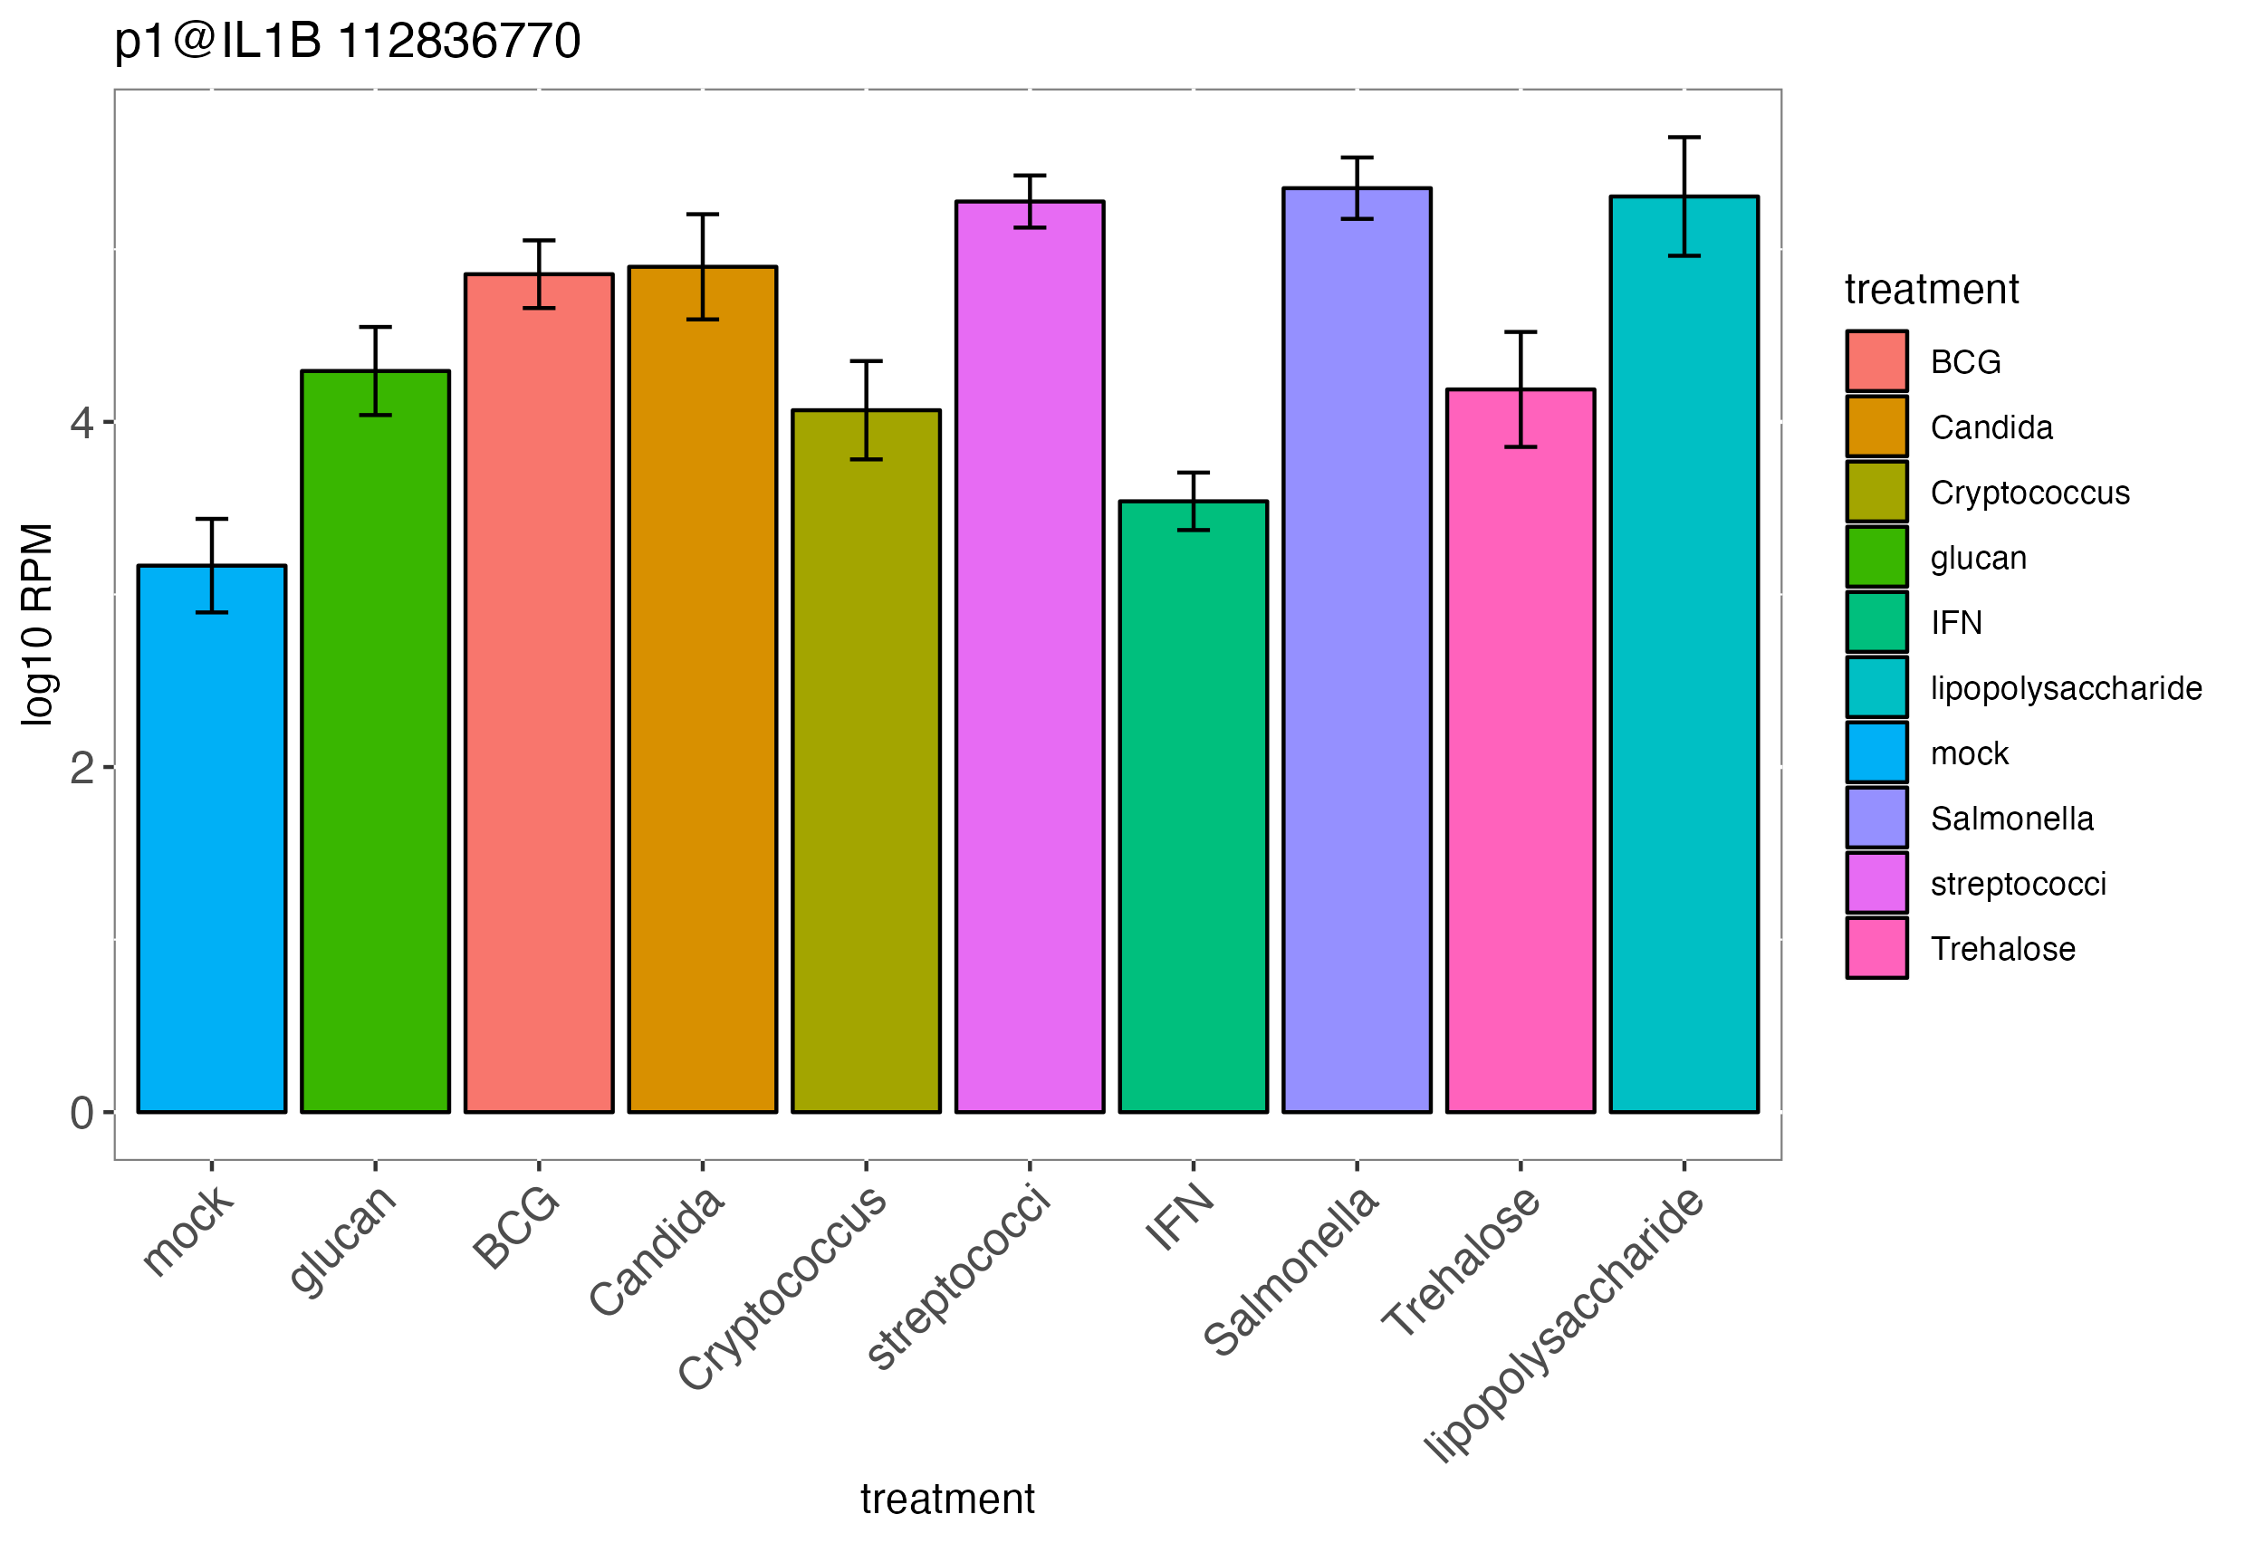
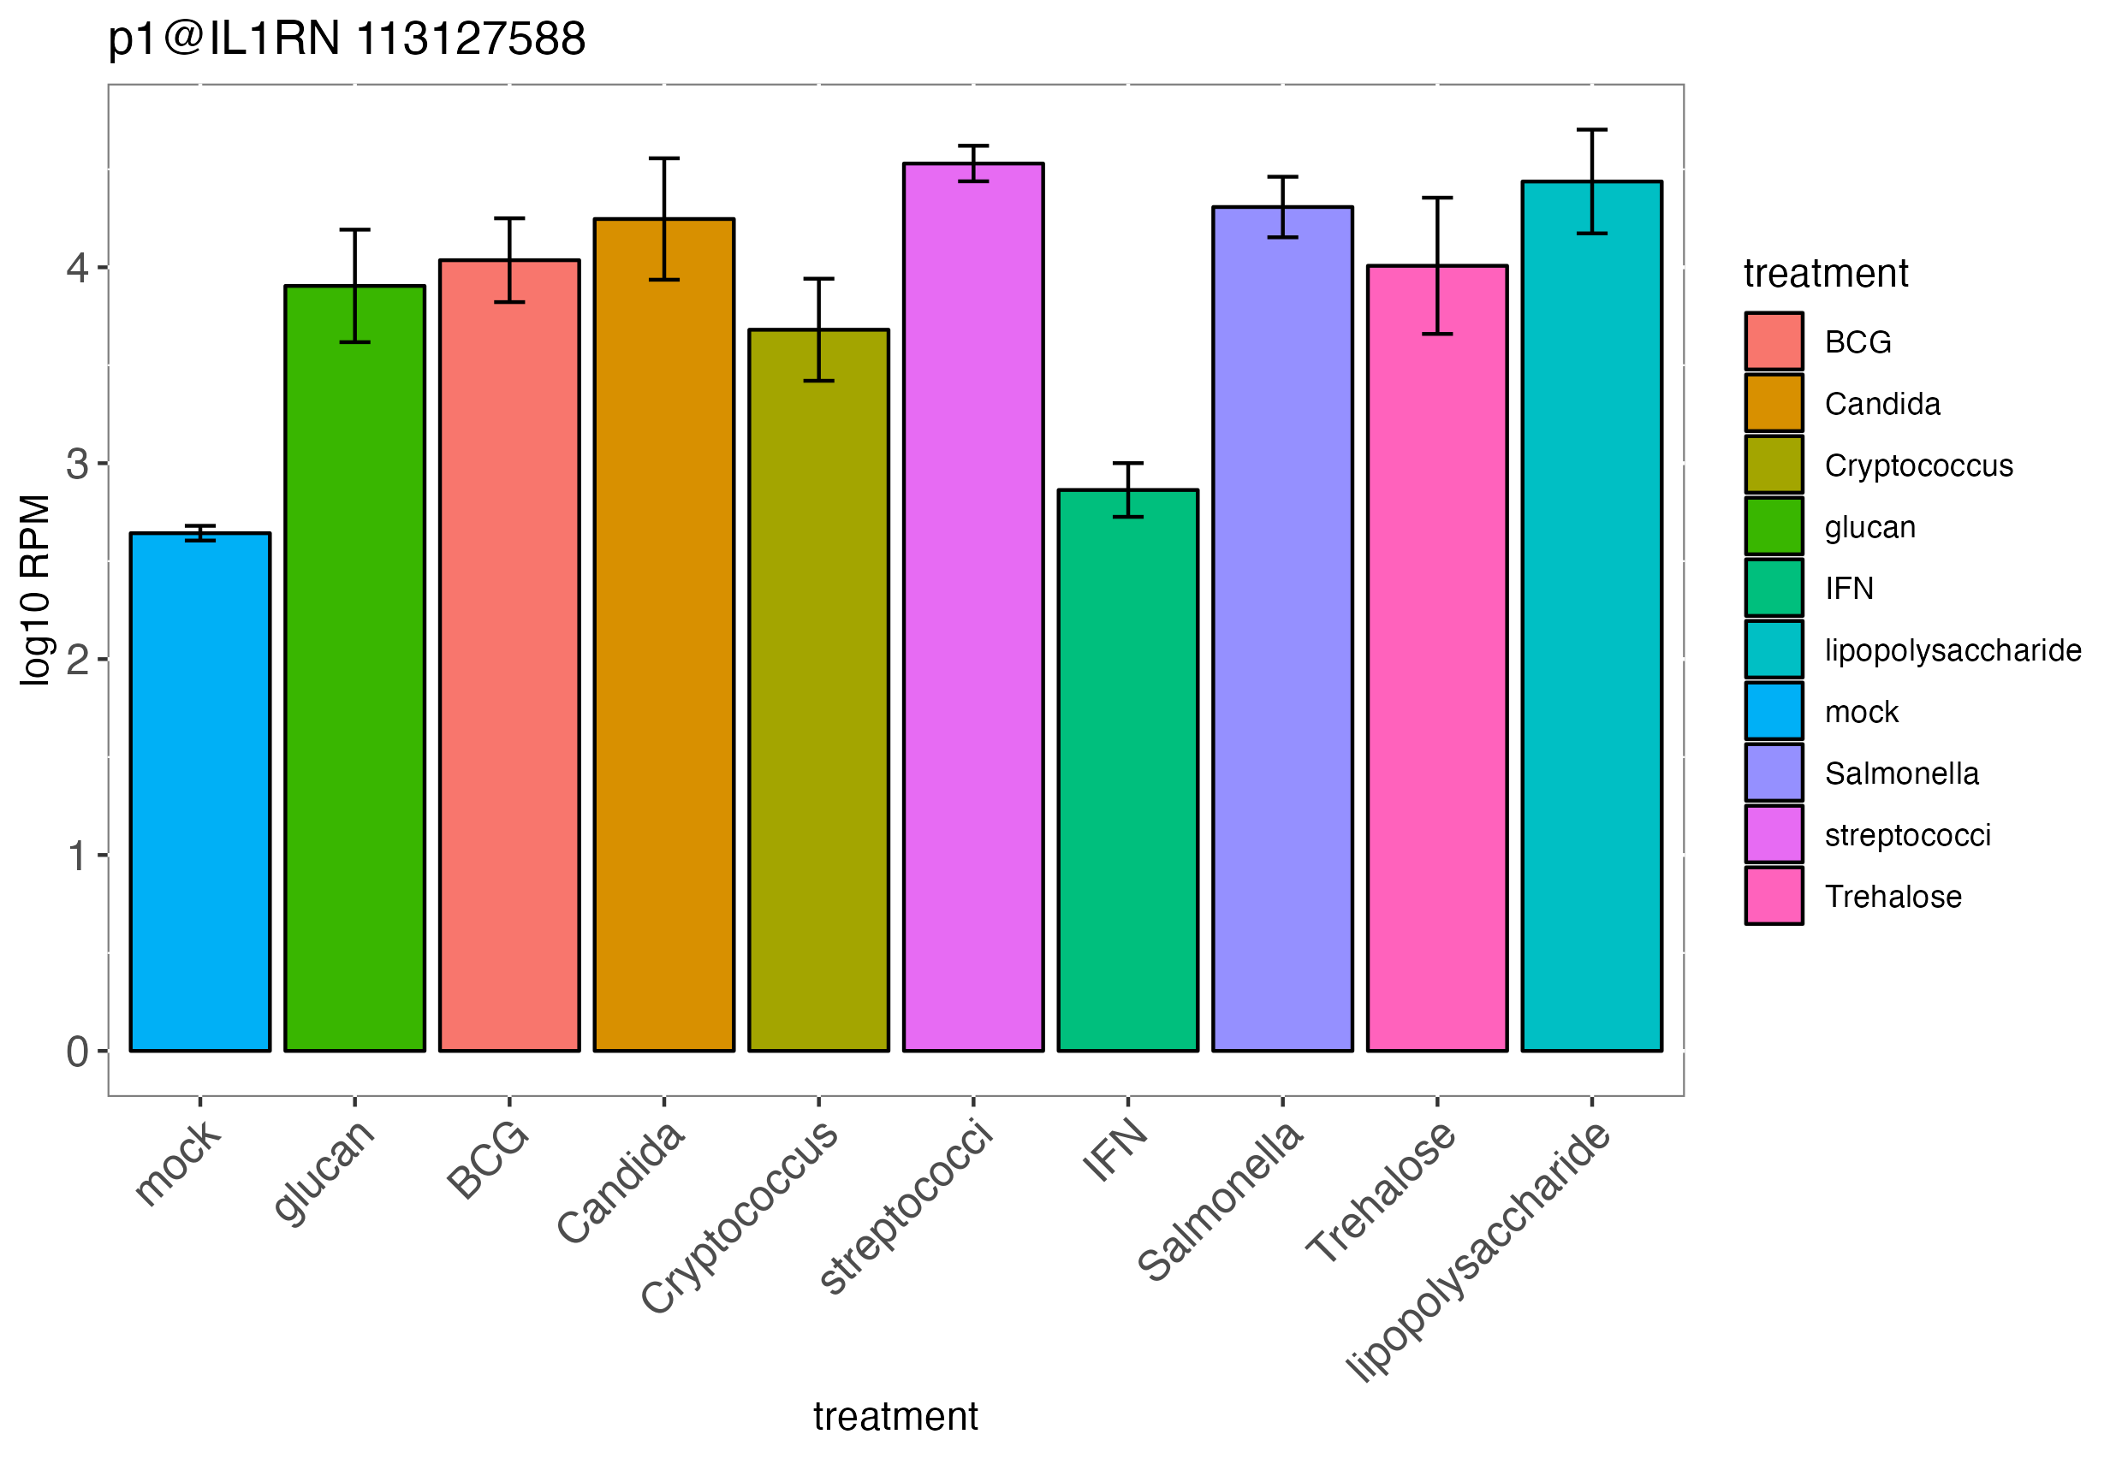

IL1RN is co-expressed with IL1B at various stimulating conditions
IL1B
IL1RN
Human monocytes, stimulated with various agents

Slide 11
Expression of IL1RN is delayed to follow IL1B
Human monocytes, stimulated with LPS
The first 5 hours
IL1RN
IL1RN
IL1B
IL1B

Slide 12
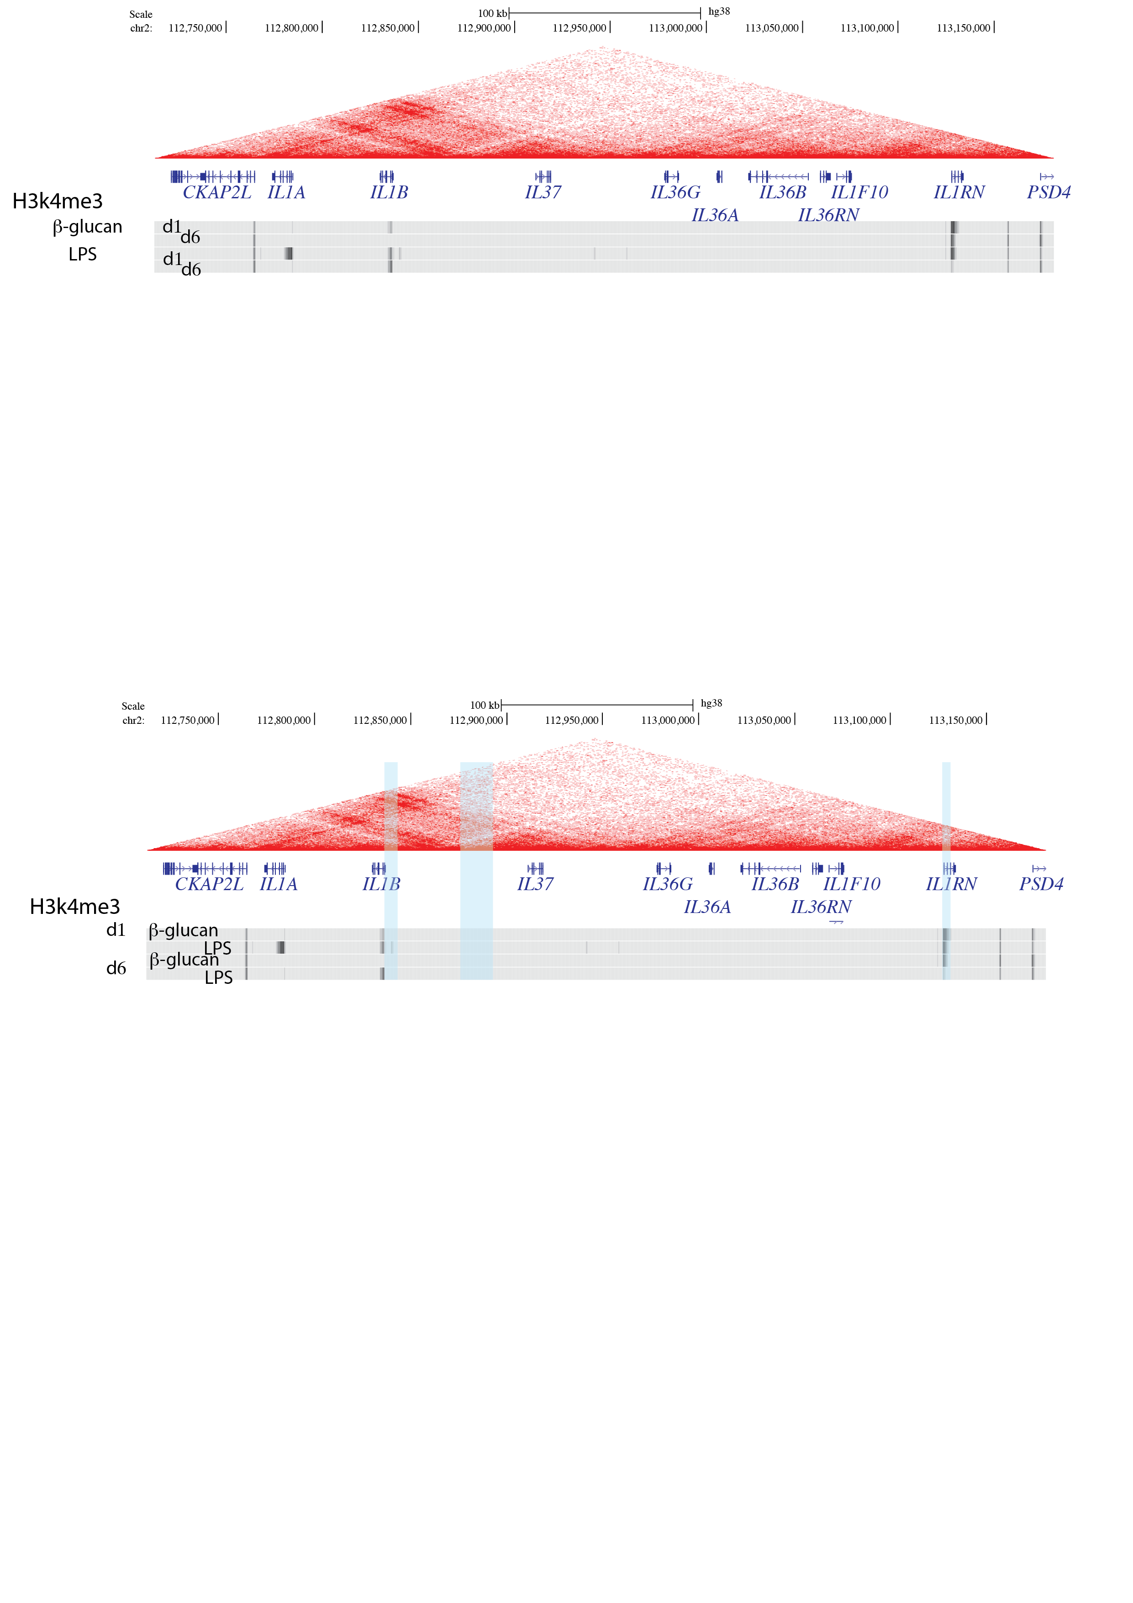

The accumulation profile of active epigenetic markers (H3K4me3) in both IL1RN and IL1B locus exhibit similar trend after stimulation with β-glucan and LPS for 1 day
Human monocytes, stimulated with β-glucan and LPS

Slide 13
Identifying the time-/stimulation- dependent conformational changes across IL1B-IL1RN region (IL1B super TAD)

Slide 14
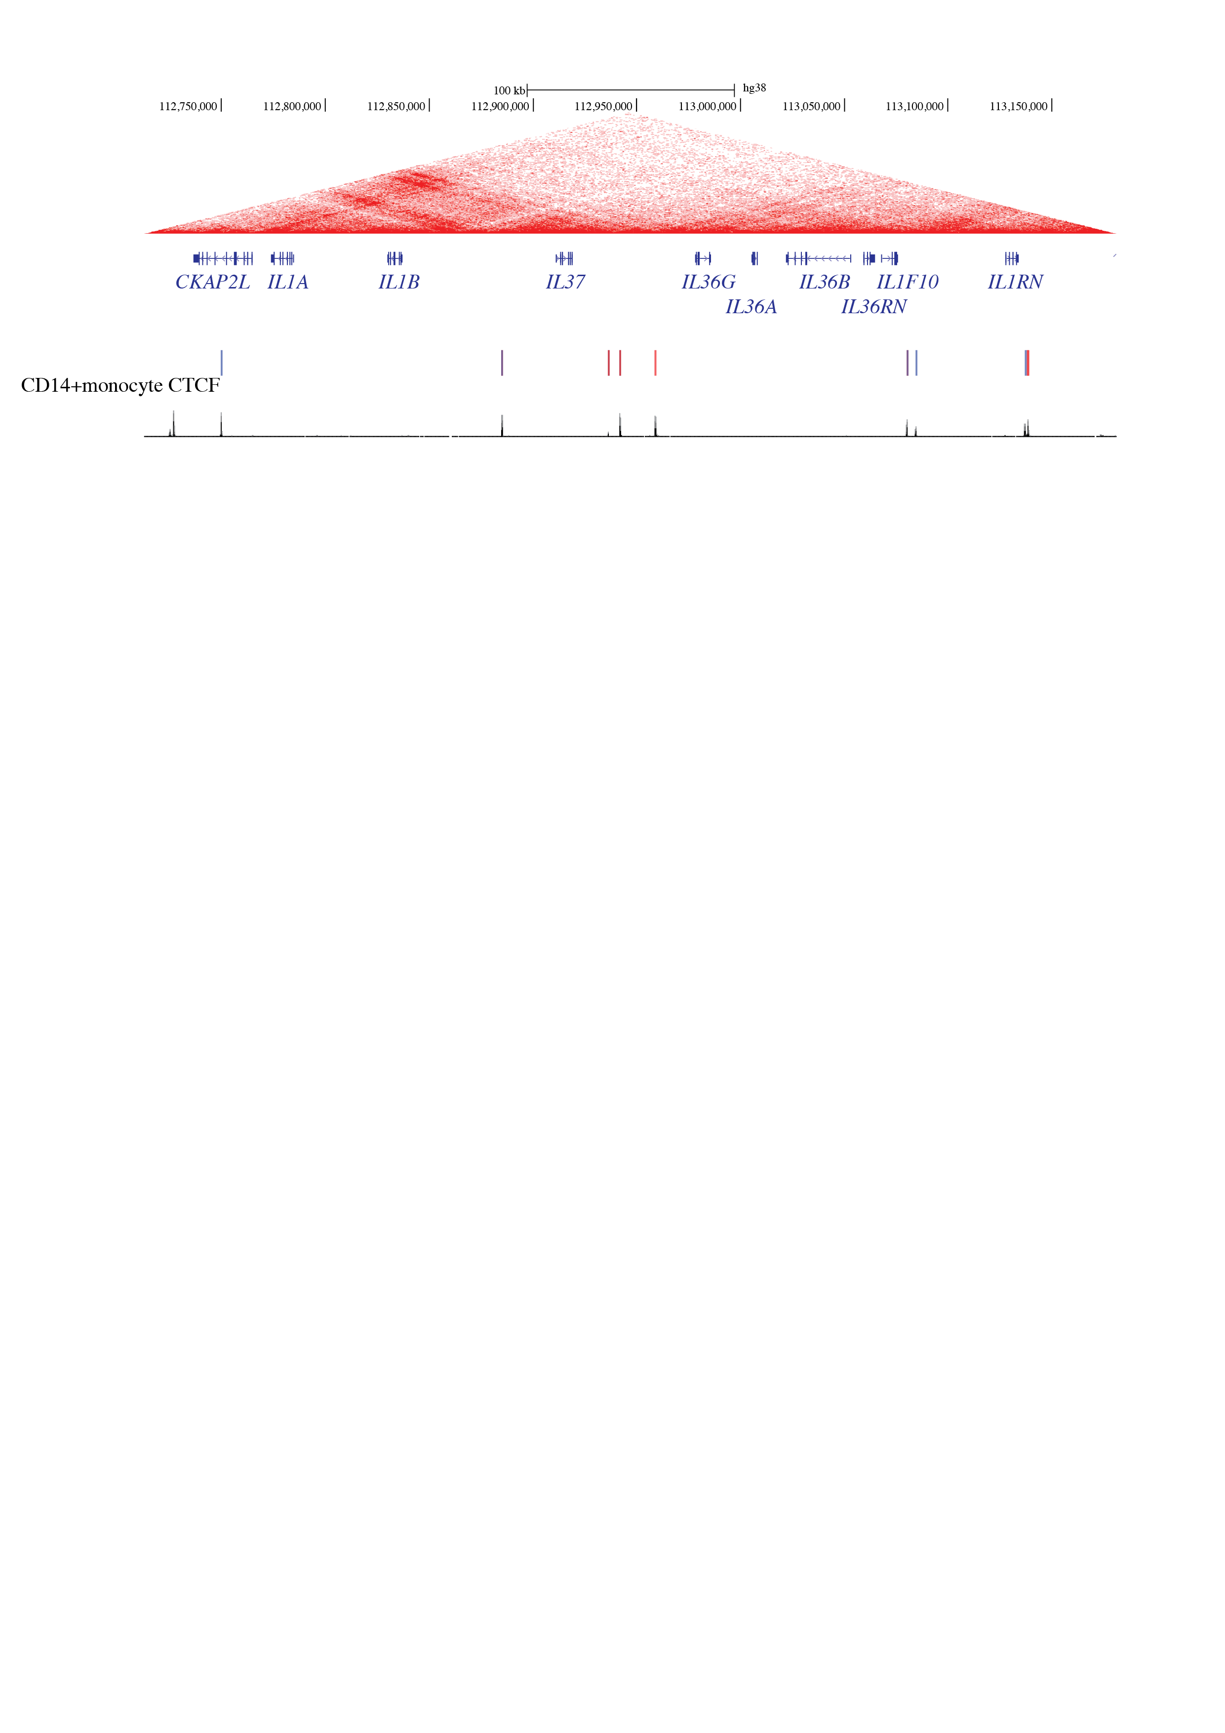
IL1B may colacalize with IL1RN throughout the time

Slide 15
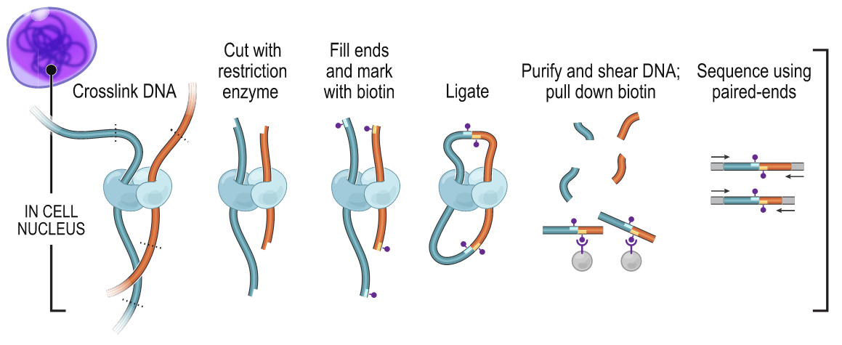
We use sequencing to capture the interaction between different chromosome regions
Lieberman-Aiden, Erez, Nynke L. van Berkum, Louise Williams, Maxim Imakaev, Tobias Ragoczy, Agnes Telling, Ido Amit, et al. Science 2009

Slide 16
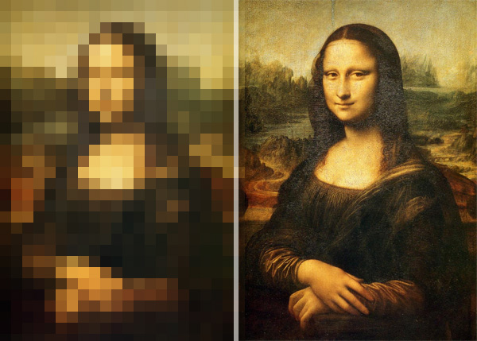
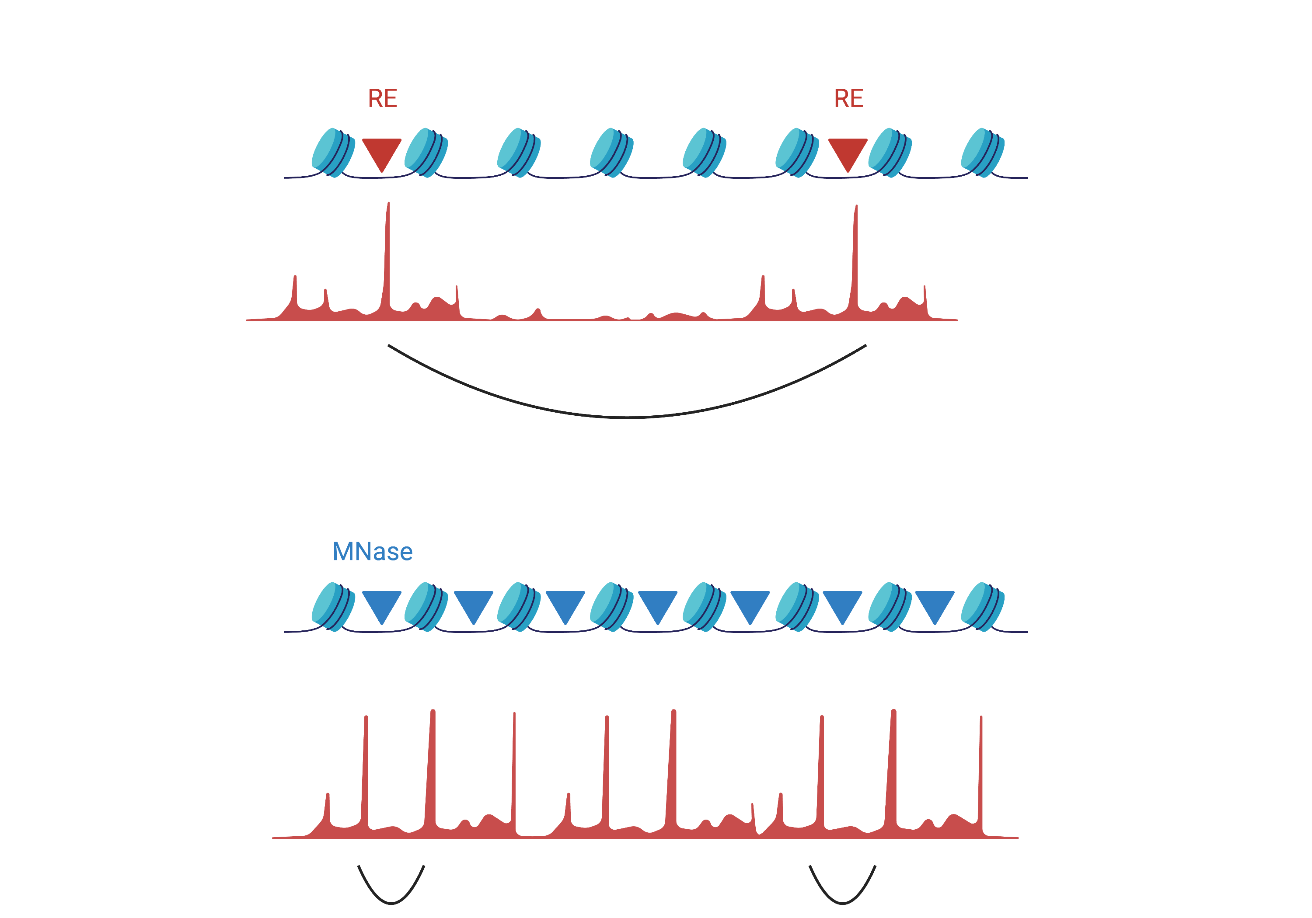
Micrococcal nuclease digestion provides interaction map single nucleosome resolution
HiC
5000 bp ~ 1MB
MicroC
146 bp ~ 10k bp

Slide 17
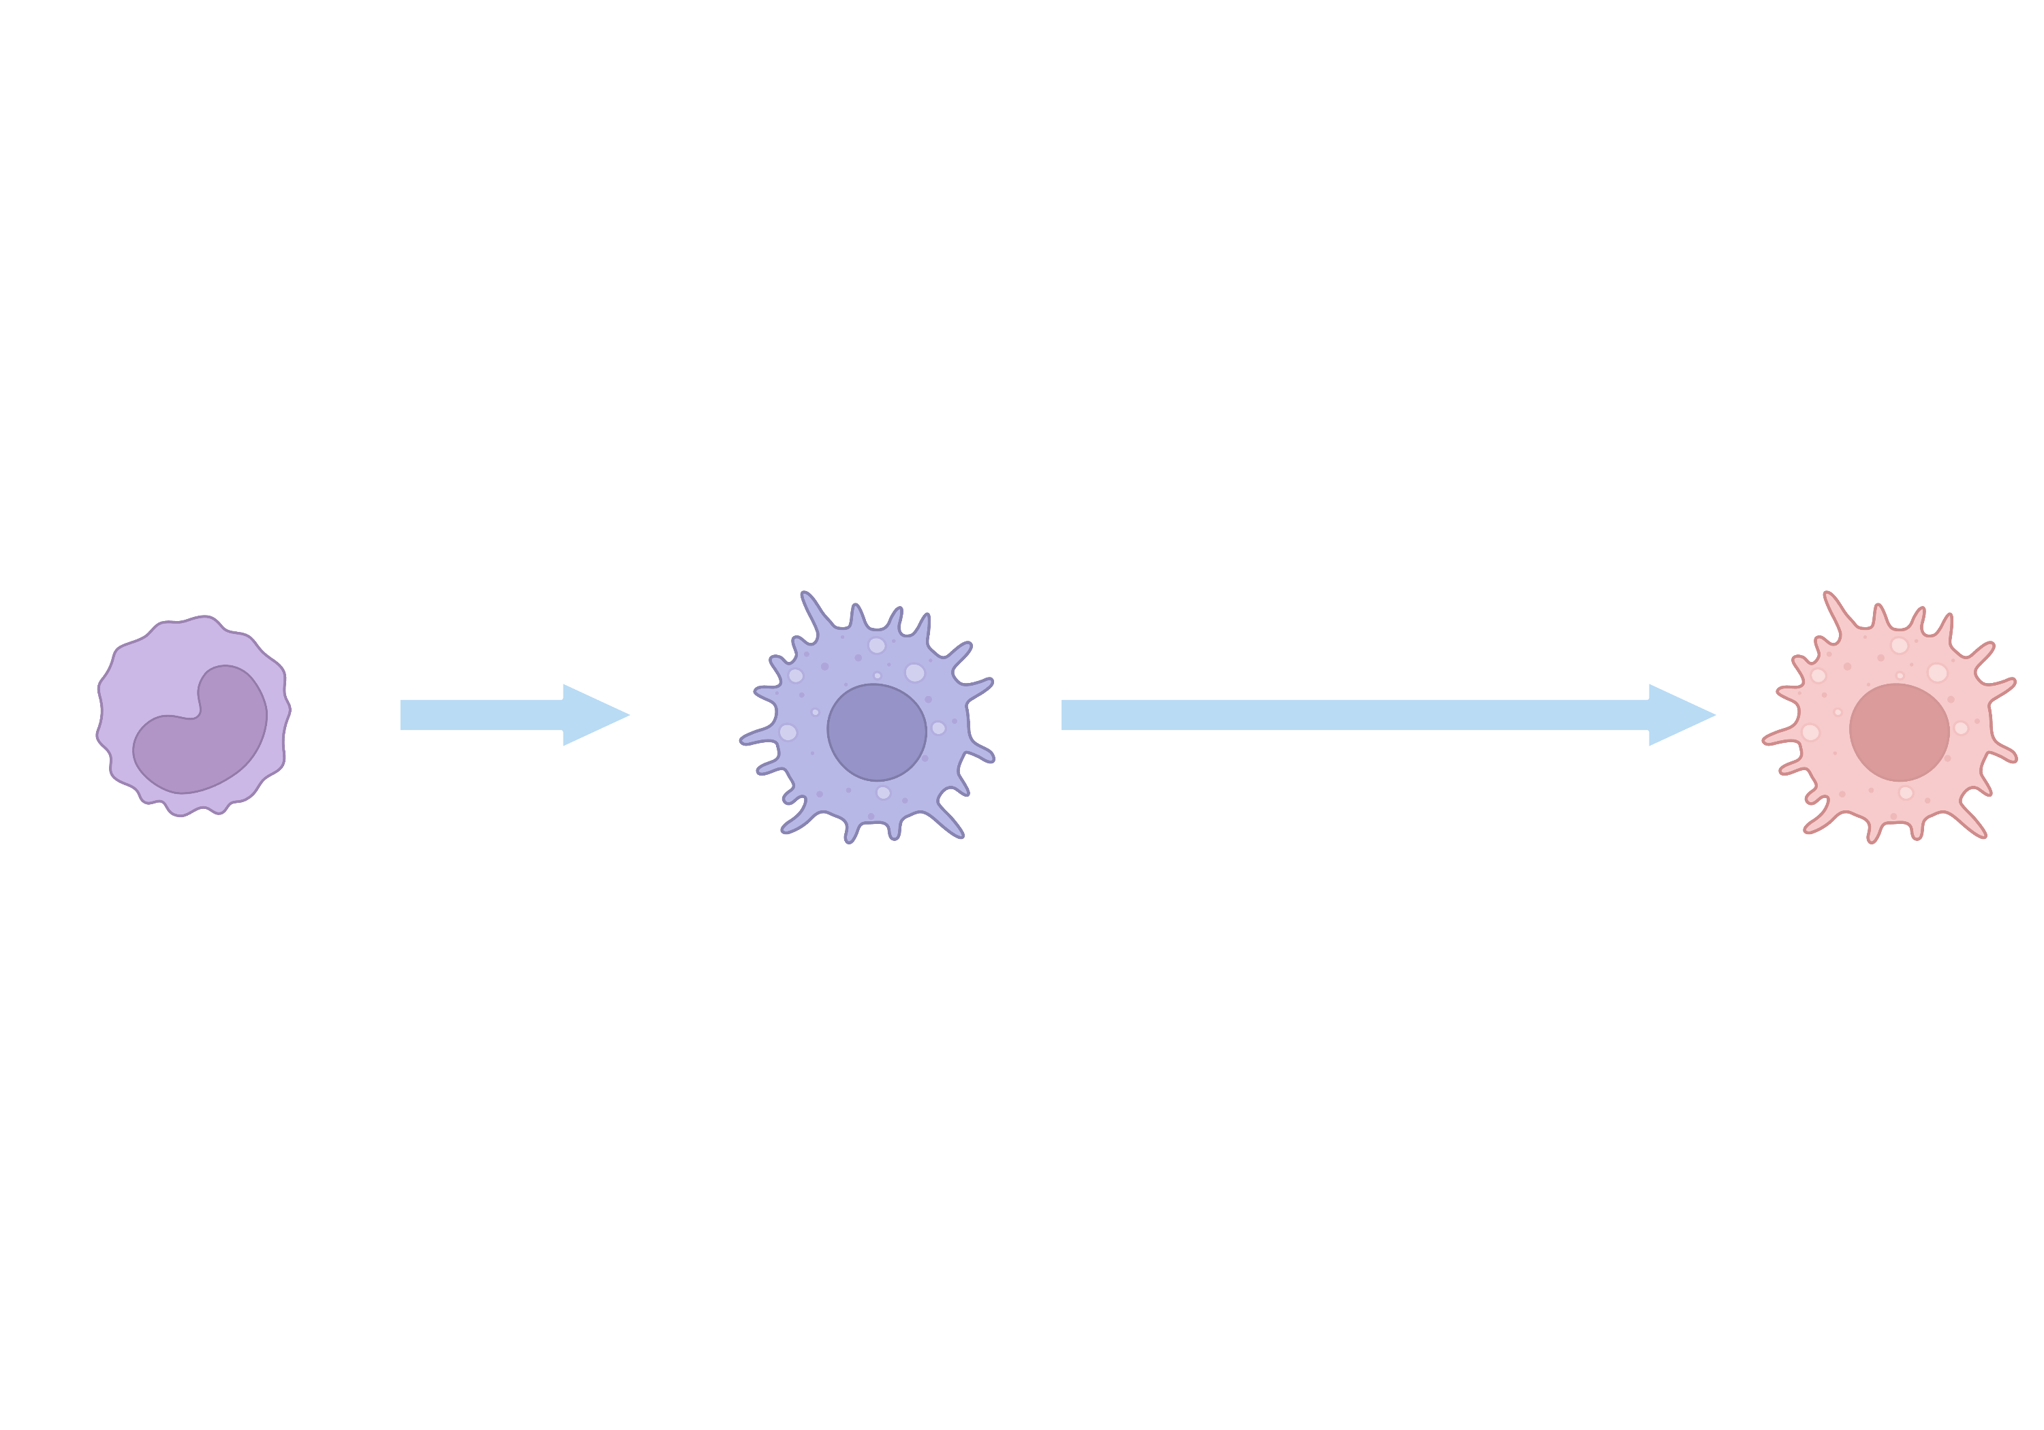
Experiment design for pilot study (THP-1)
Stimulatants:
LPS
1d
Monocytes
Macrophages
Day 0
Day 1
MicroC
MicroC

Slide 18
Experiment design
Stimulatants: β-glucan, LPS, BCG
1d
5d
Monocytes
Macrophages
Trained macrophages
MicroC
MicroC
MicroC
4C
4C

Slide 19
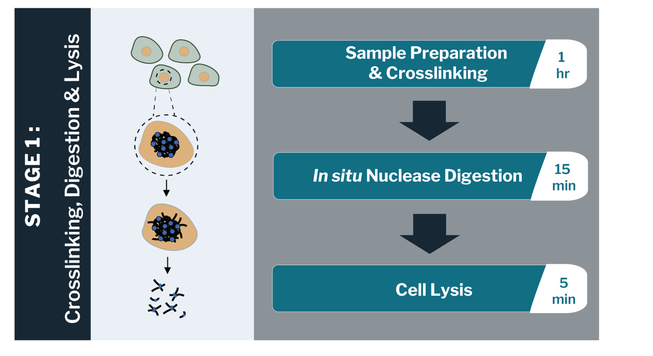
Problems
Trouble!!

Slide 20
Solutions
Increase the cell number -> X (especially for trained cells)
Do not use trypsin during harvesting -> X
Change the fixation buffer to PBS containing Ca++ -> X
Change the fixation buffer to medium containing serum -> Works, but still a lot of cells are lost.
Increase the cell number, change the fixation buffer to medium containing serum, and decrease the volume of Dovetail washing buffer -> Works

Slide 21
QC (Mnase digestion)
A, d6, control
A, d6, β-glucan-treated
42%
46%
C, d6, control
51%
C, d6, LPS
48%

Slide 22
The comparison basis should be unstimulated cells at day 5
A, d0, control
A, d6, control
A, d6, β-glucan-treated
68%
42%
46%

Slide 23
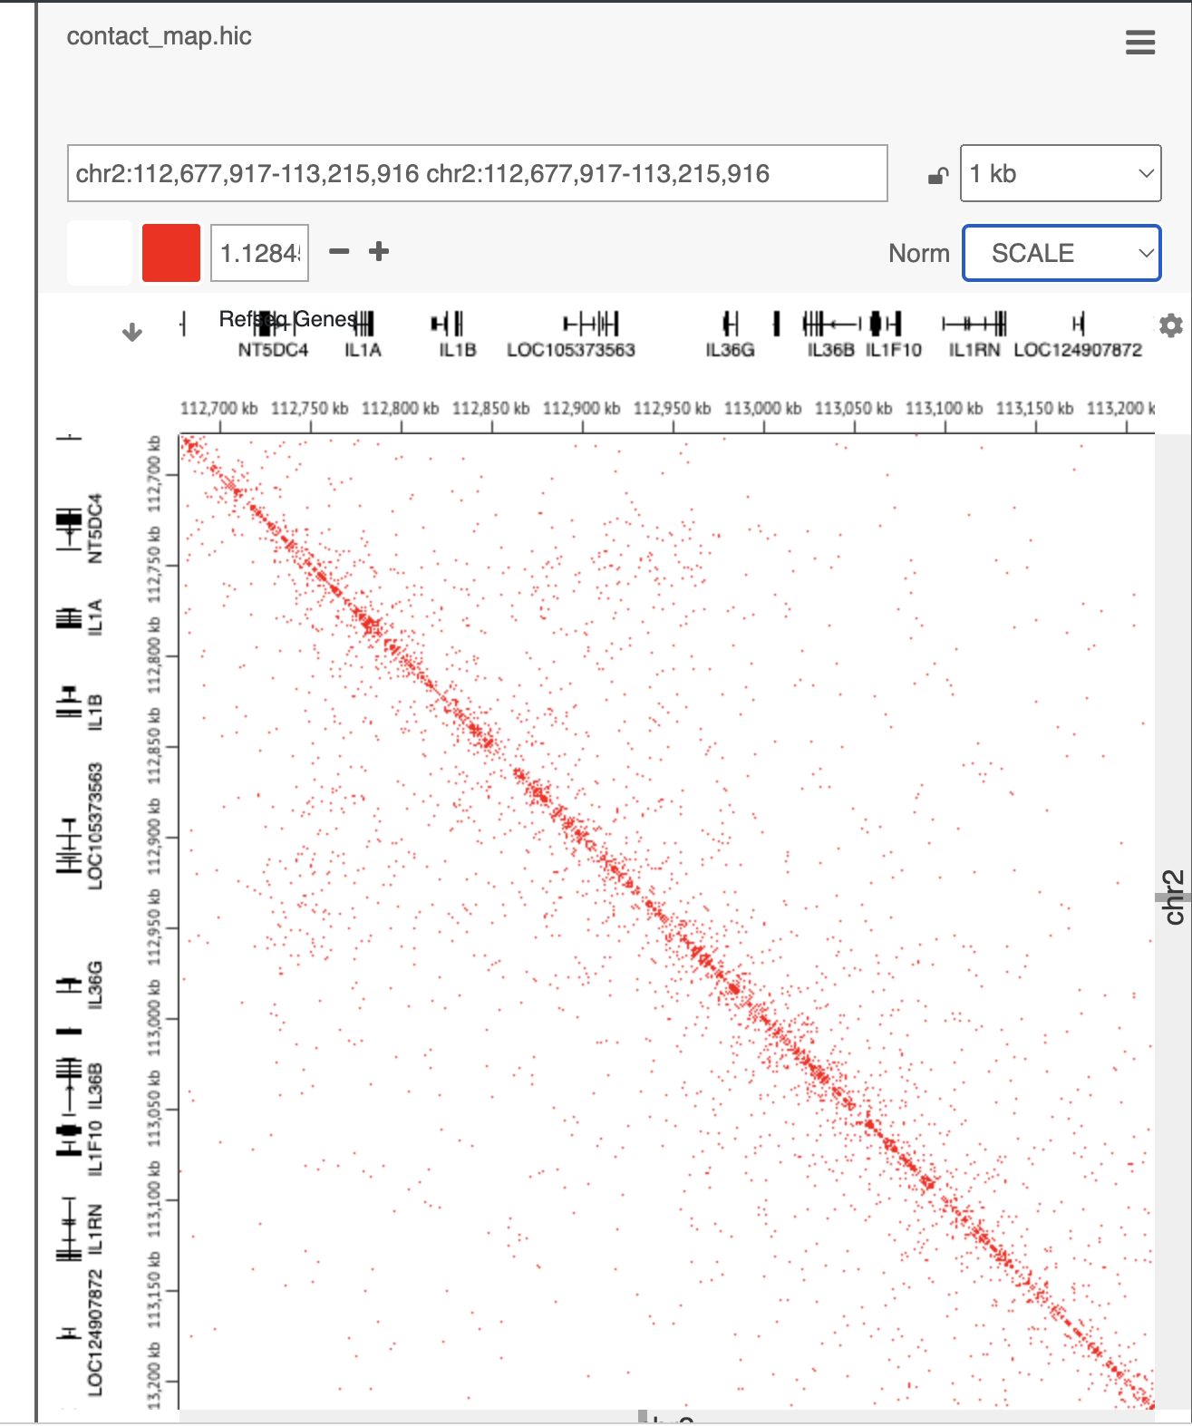
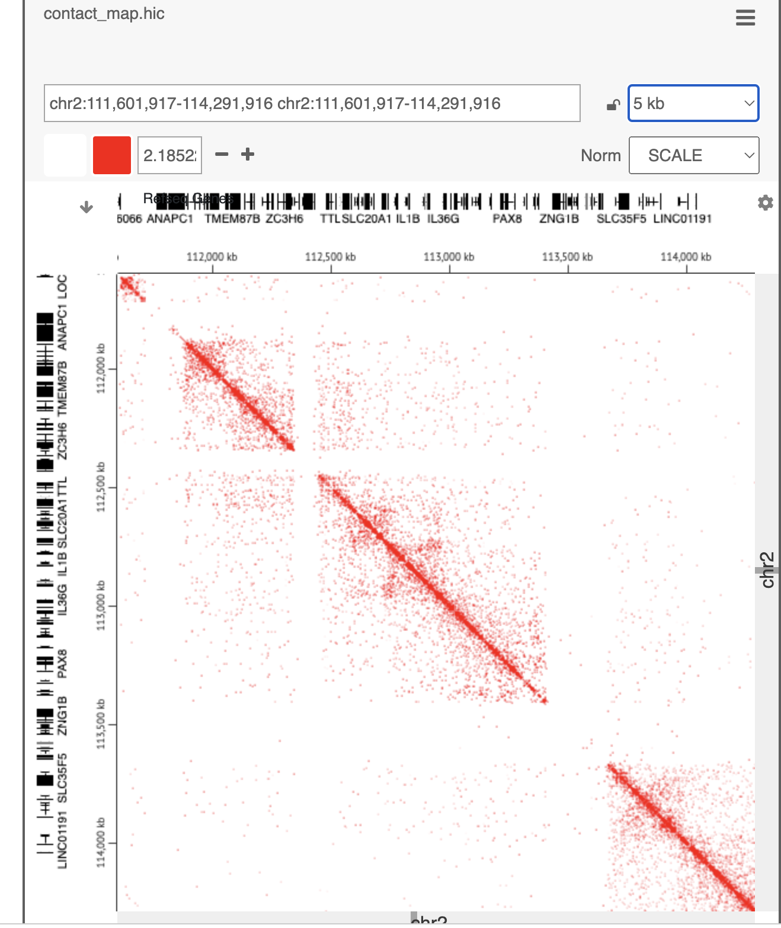
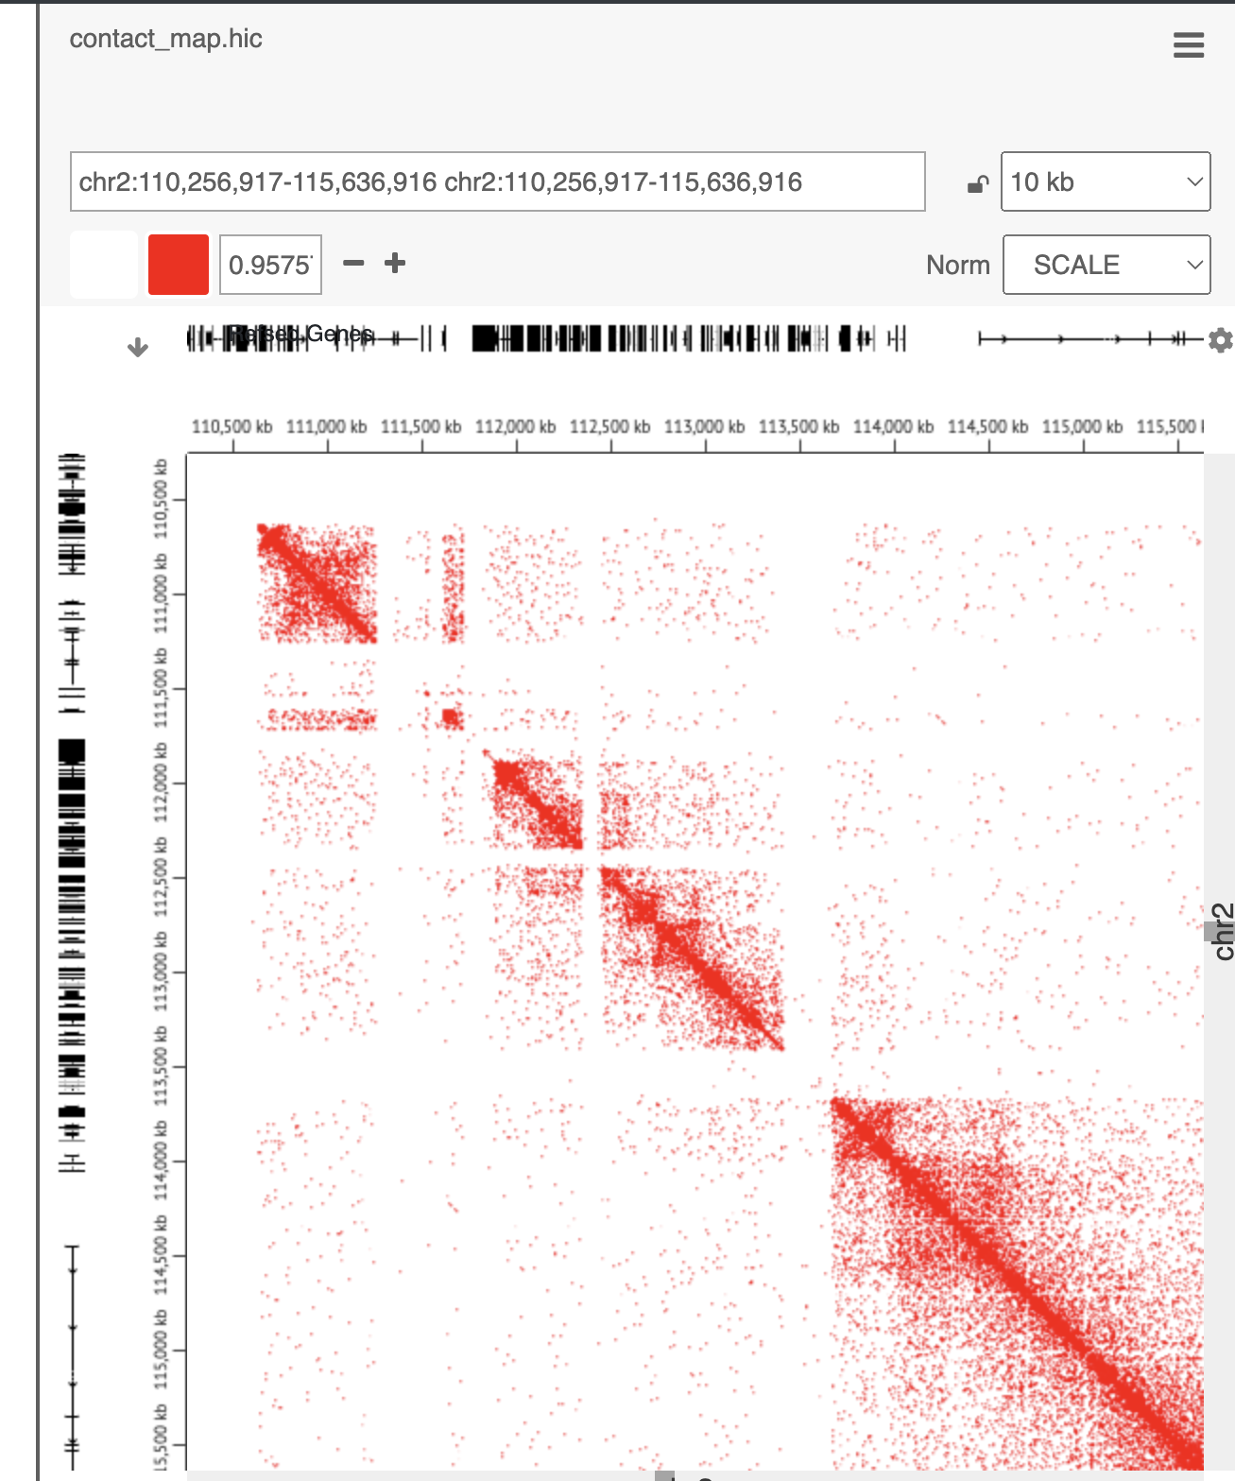
Data for THP-1
IL1B super TAD (1127500 – 113000kb)
1kb
5kb
10kb

Slide 24
Sample matrix (microC): They became libraries or on the road to become libraries
Cell types | Stimulation | Time points (Day) | Donor | Progress
THP-1 | Medium | 0 |  | Not performed
THP-1 | LPS | 1 |  | Done
Monocytes | Medium | 0 | Donor A (2023-6-19) | Lysates
Monocytes | Medium | 0 | Donor A (2023-6-19) | Library
Monocytes | B-glucan | 5 | Donor A (2023-6-19) | Library
Monocytes | Medium | 5 | Donor C (2023-6-19) | Lysates
Monocytes | Medium | 0 | Donor C (2023-6-19) | Library
Monocytes | LPS | 5 | Donor C (2023-6-19) | Library
Monocytes | BCG | 0 |  | Not started yet
Monocytes | BCG | 5 |  | Not started yet
Monocytes | BCG | 5 |  | Not started yet

Slide 25
Future works
Low resolution.
Read numbers are not enough? (ask 300M but only have 96M)
Increase the read numbers.
Prepare library monocytes under various stimulations / replicate

Slide 26
Searching for lncRNA near IL1RN TSS

Slide 27
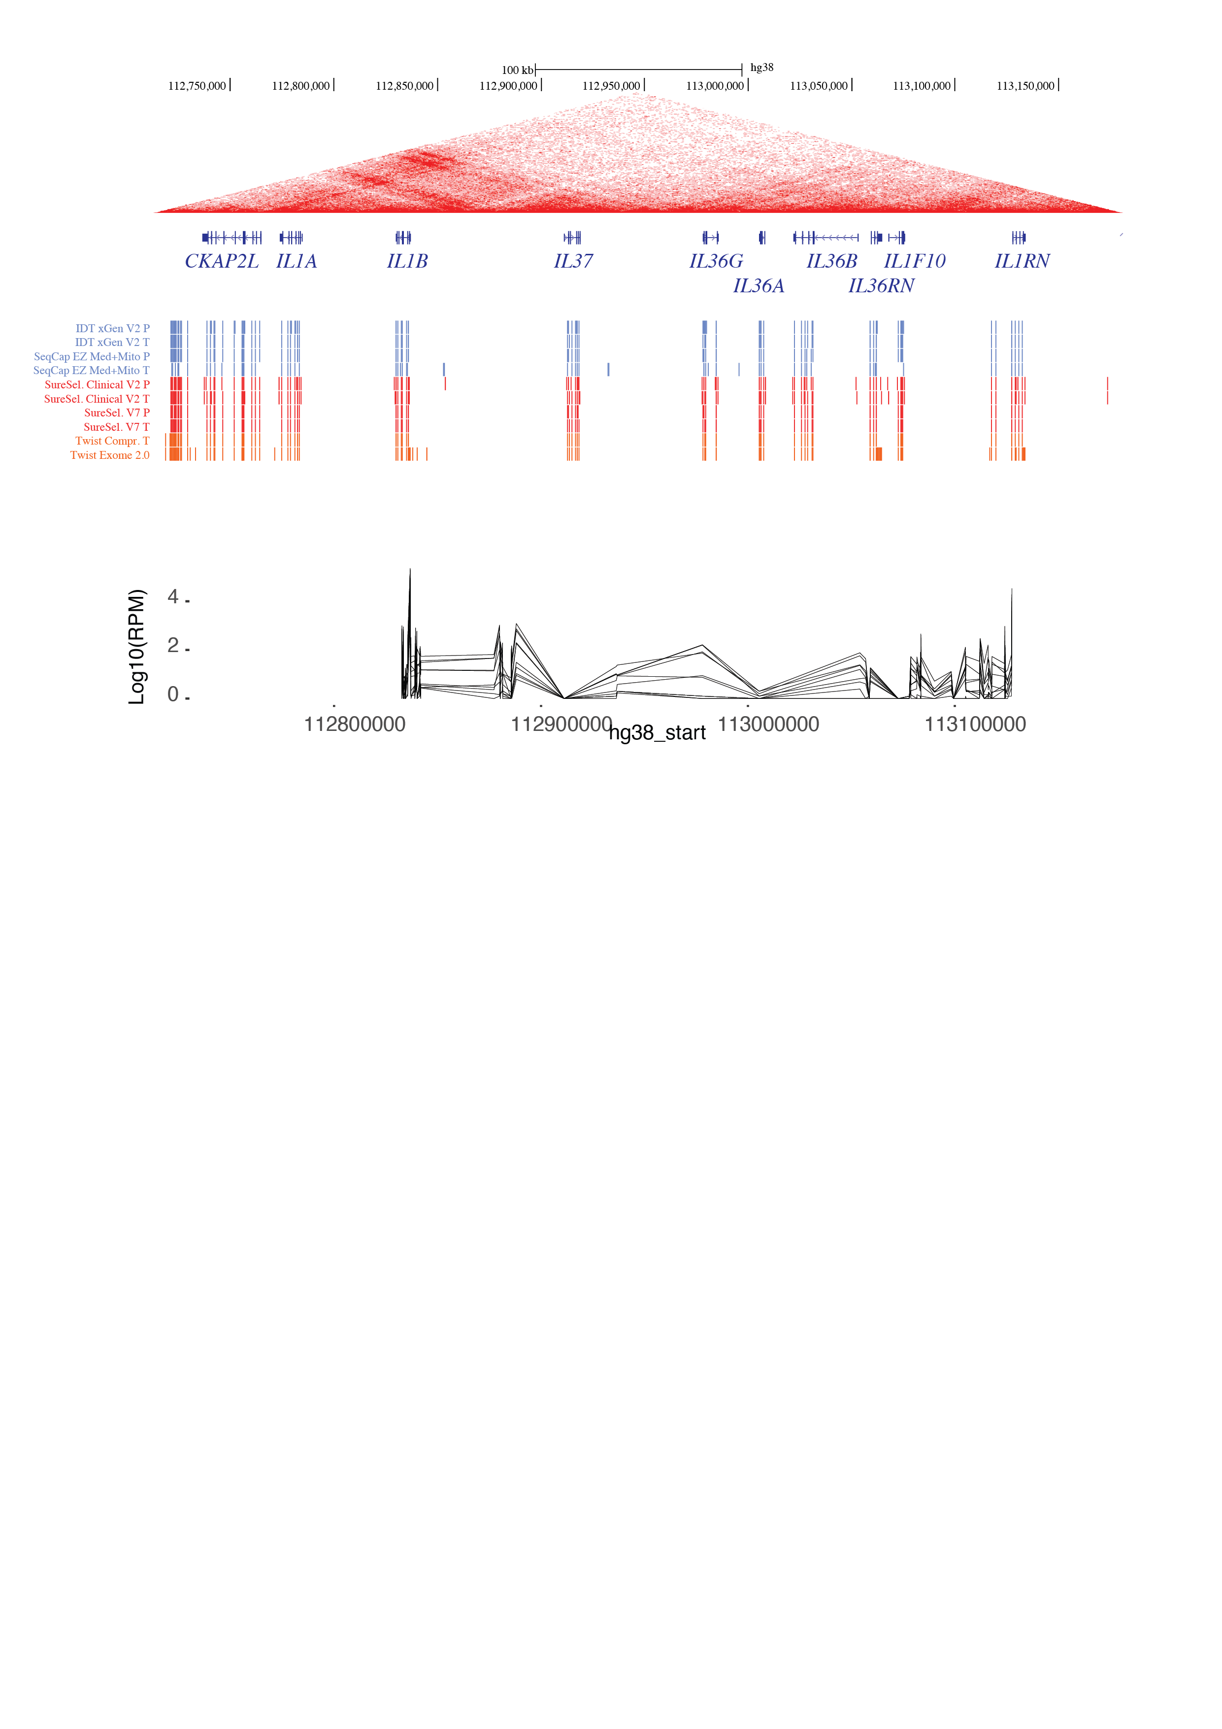
Searching for lncRNA near IL1RN TSS

Slide 28
lncRNAs have expression level comparable to IL1B and IL1RN
IL1B p1
AMANZI
IL1RN p1

Slide 29
lncRNAs that are near IL1RN as well as having expression level comparable to IL1B and IL1RN
IL1B p1
AMANZI
IL1RN p1
30274.1
22093.1
22100.1

Slide 30
lncRNAs that are near IL1RN as well as having expression level comparable to IL1B and IL1RN

Slide 31
Thanks
Musa
Niels, Lara, Xiaolin, Jessen
Noriko*, Mumin*, Yutaka san*, Janine*
* The order is determined by how many tips/tubes that I steal from

Slide 32
Sample matrix (4C)
Cell types | Stimulation | Time points (Day) | Donor | Progress
THP-1 | Medium | 0 |  | Done
THP-1 | LPS | 1 |  | Done
Monocytes | Medium | 0 | Donor B (2023-5-2) | Done
Monocytes | LPS | 1 | Donor B (2023-5-2) | Done
Monocytes | Medium | 0 | Donor C (2023-5-2) | Done
Monocytes | B-glucan | 1 | Donor C (2023-5-2) | Done

Slide 33
IL1B colocalizes with two anti-inflammatory genes IL37 and IL1RN

Slide 34
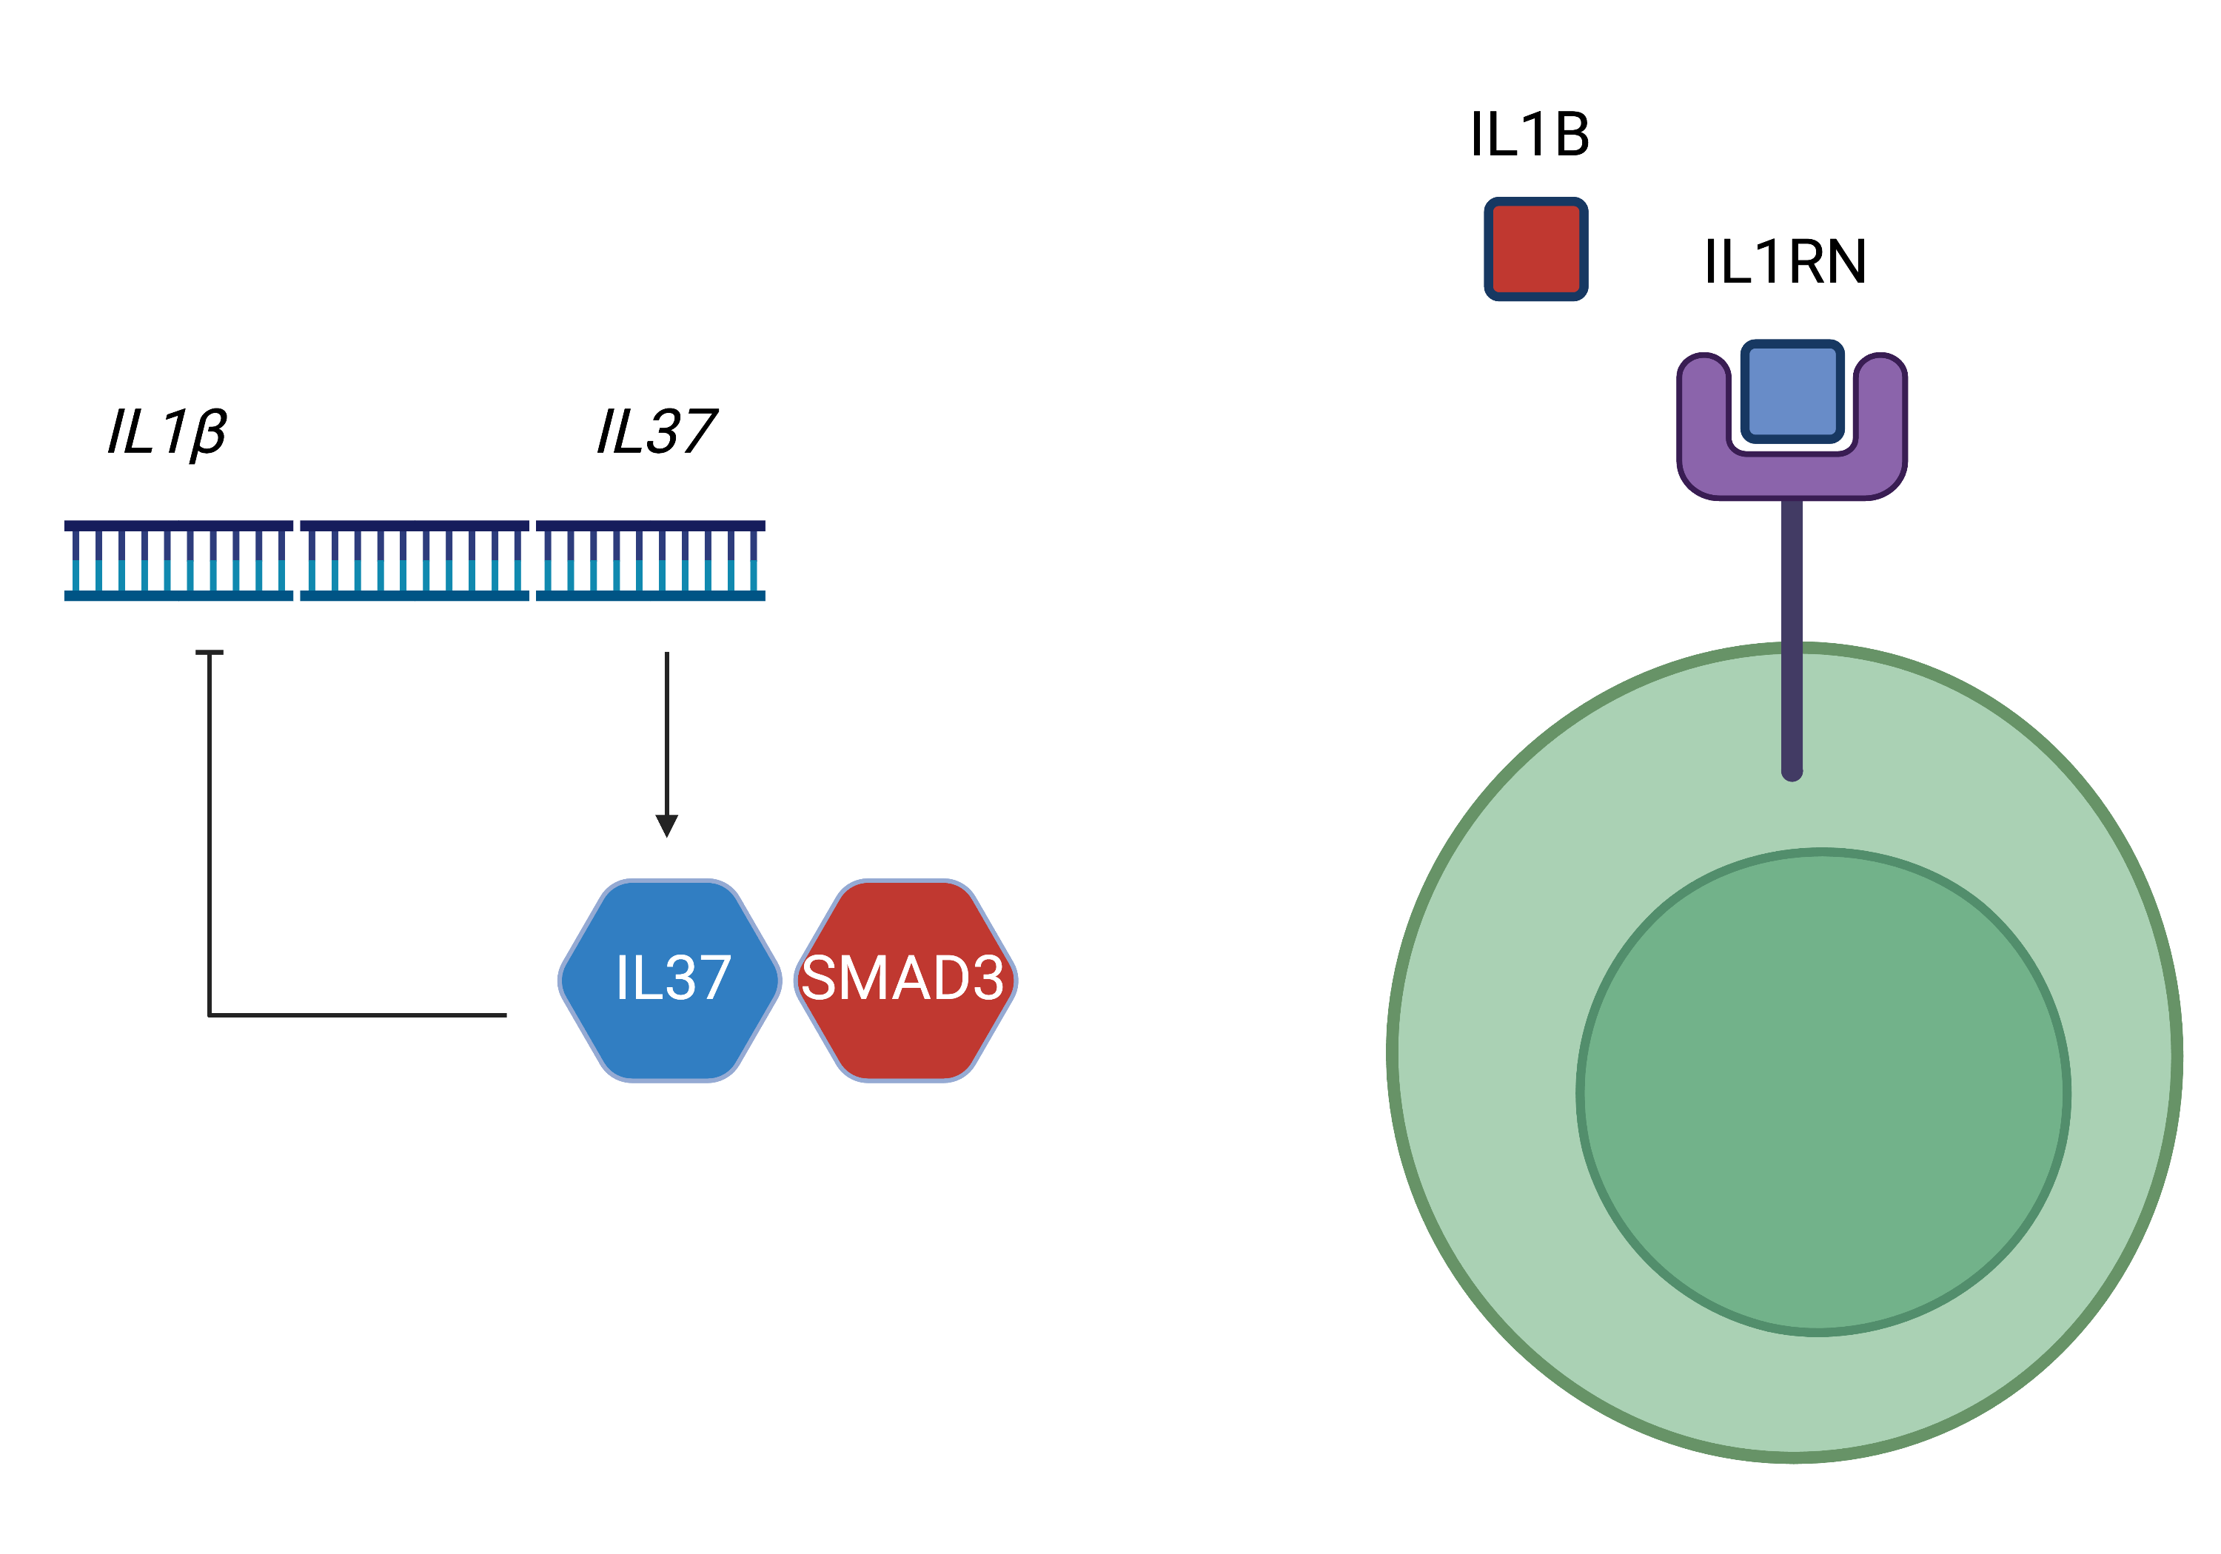
Different anti-inflammation mechanisms of IL37 and IL1RN

Slide 35
Goal: building the dynamic interaction map with various stimulus
Stimulatants
Monocytes
Macrophages
Trained macrophages

Slide 36
Experiment design for human monocytes (Single donor)
Stimulatants: Control (Medium) LPS β-glucan
Lara’s work
Monocytes
Macrophages
Trained macrophages
Day 0
Day 0.5
Day 1
Day 6
4C
4C
4C
4C

Slide 37
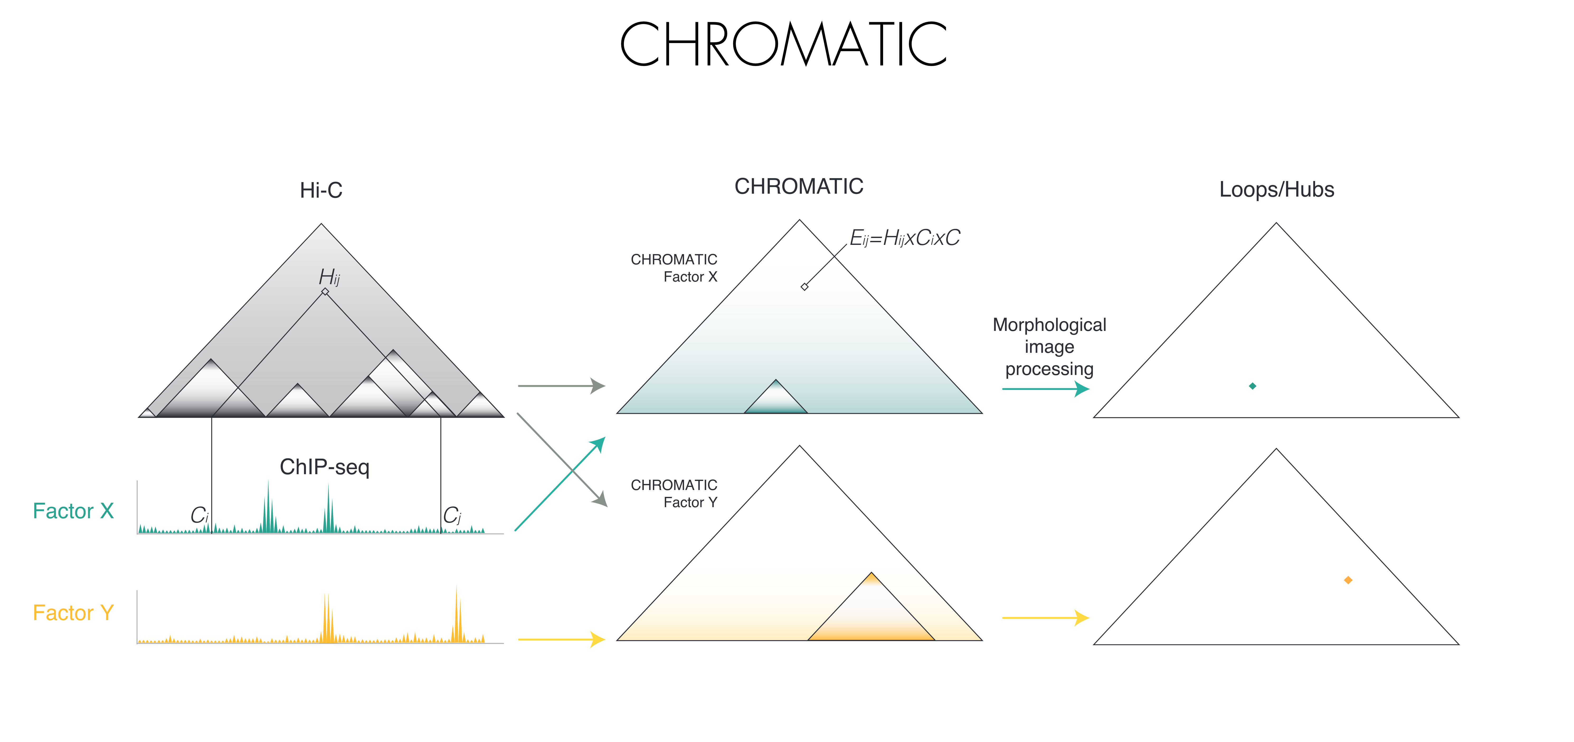
Chromatic: microC + ChIPseq
Credit: Marc’ A. Marti-Renom at ICREA

Slide 38
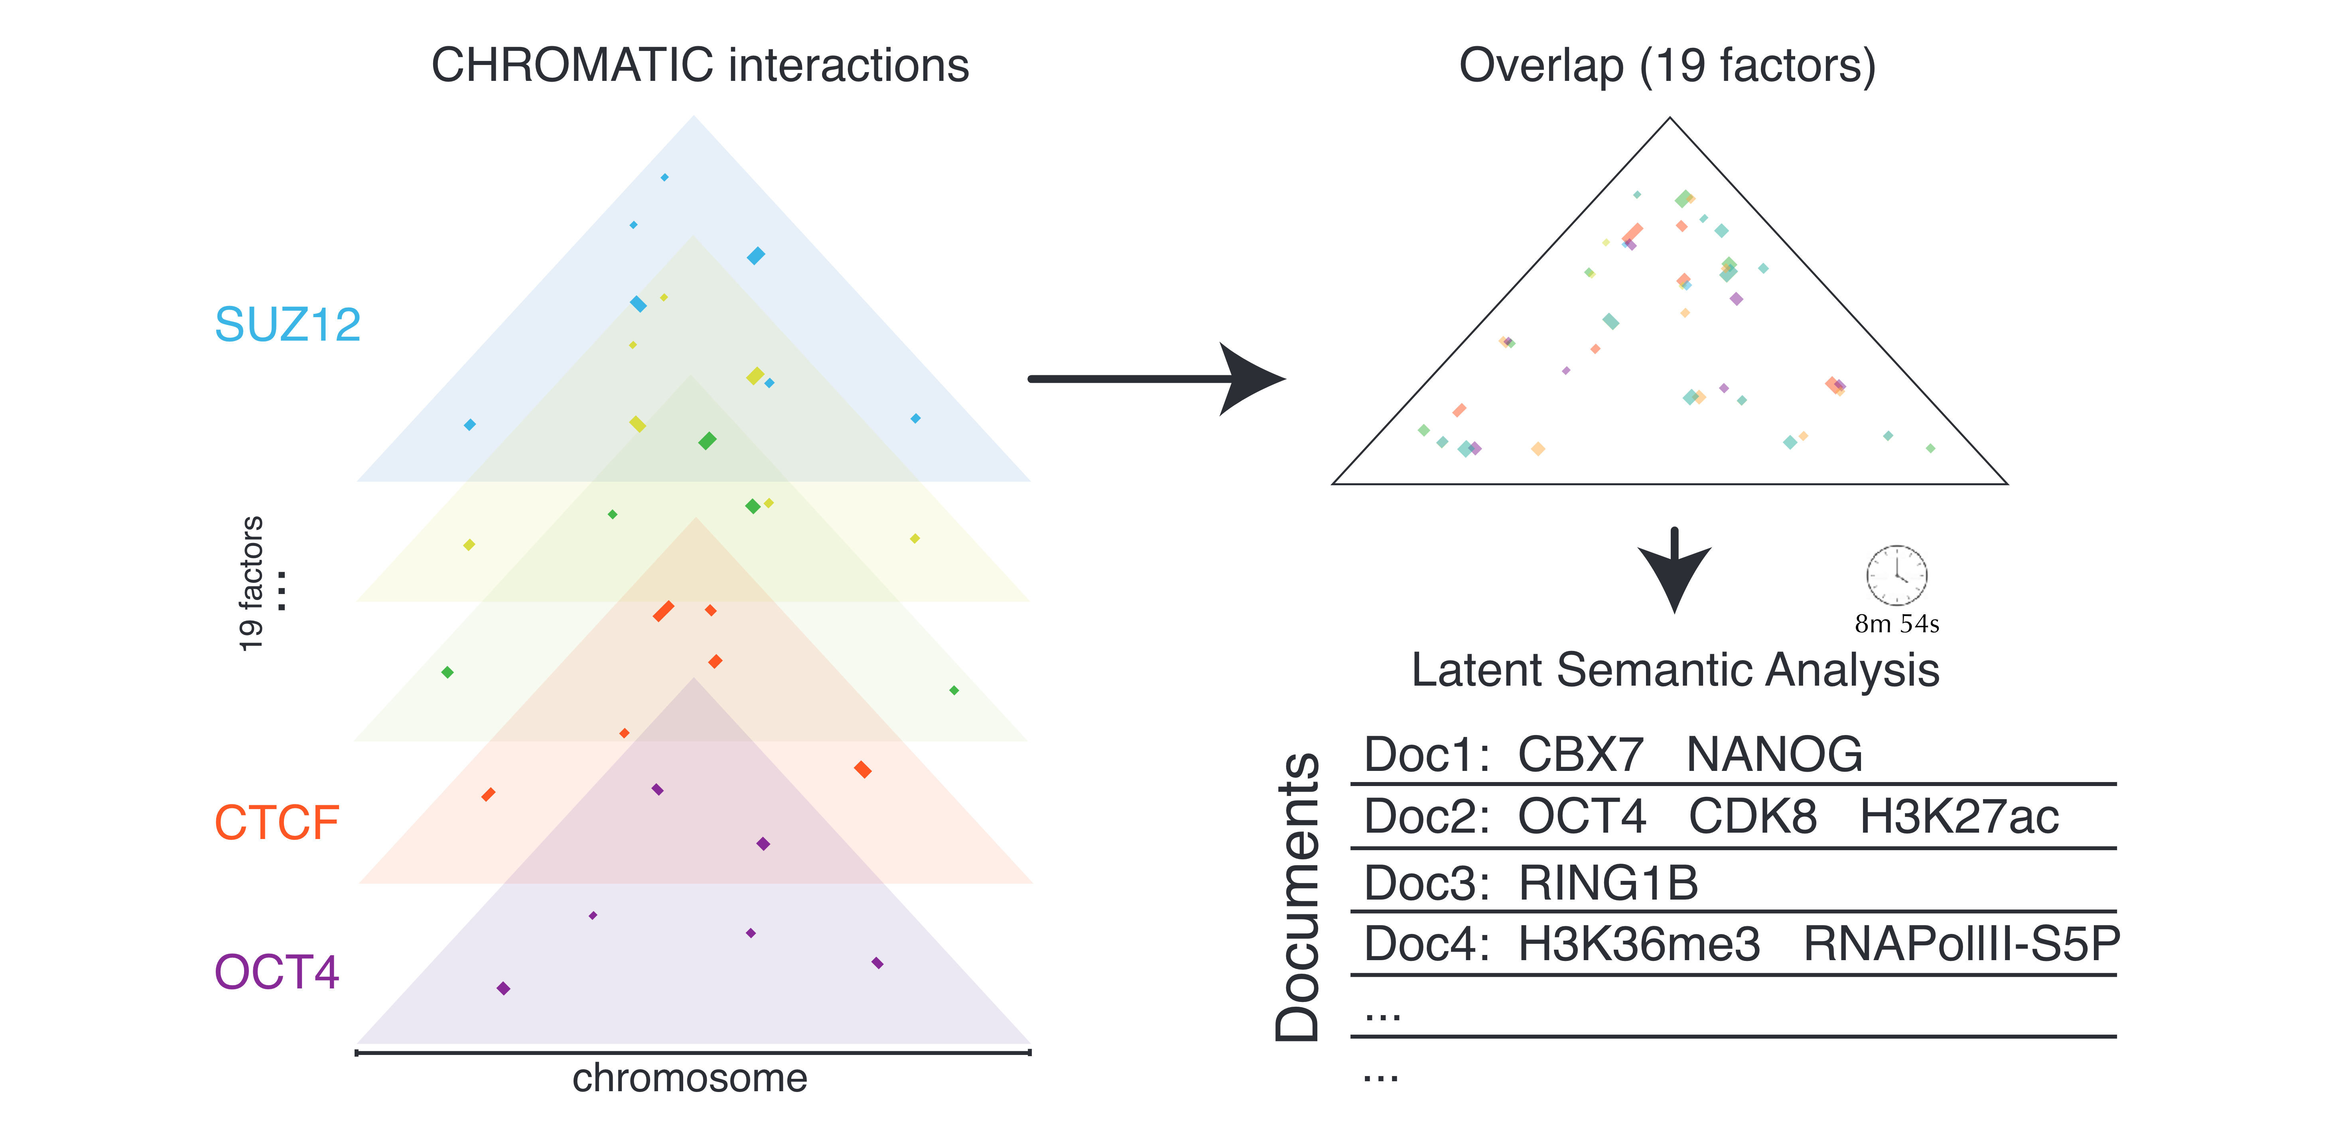
Chromatic: measure 3D co-localization of factors
Credit: Marc’ A. Marti-Renom at ICREA

Slide 39
We will build a time-series Chromatic map for monocytes with various training agents
Stimulatants: Control (Medium) b-glucan LPG
Monocytes
Macrophages
Trained macrophages
Day 0
Day 1
Day 5
MicroC
MicroC
MicroC
TF-ChIPseq
TF-ChIPseq
TF-ChIPseq
HM-ChIPseq
HM-ChIPseq
HM-ChIPseq

Slide 40
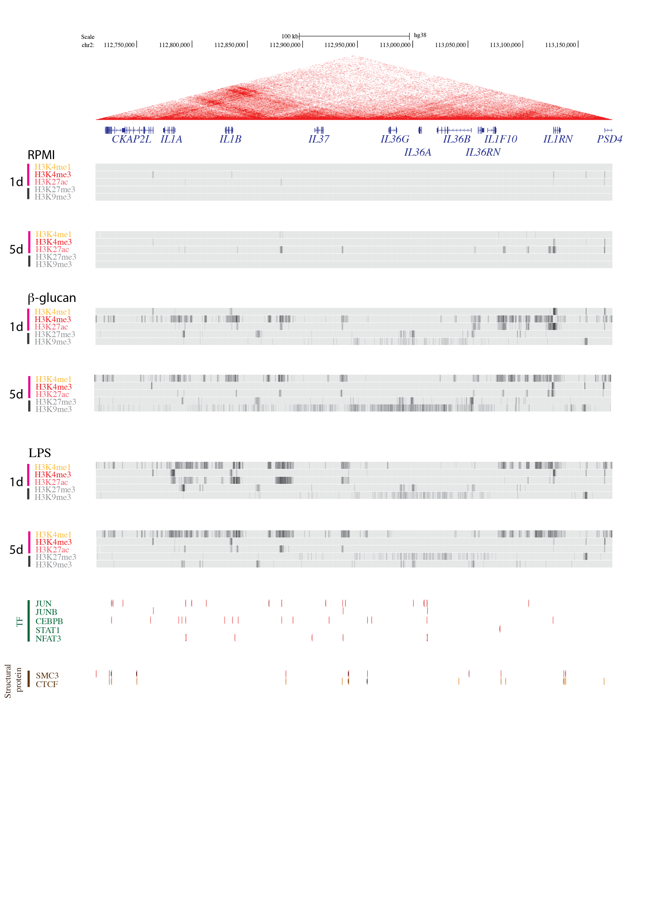
Combining with public ChIP-seq data
Day
0
6
RPMI

Slide 41
Combining with public ChIP-seq data
Day
0
6
β-glucan

Slide 42
Combining with public ChIP-seq data
Day
0
6
LPS

Slide 43
Combining with public ChIP-seq data
Day
0
6
Leishmania lysate

Slide 44
Chromatic

Slide 45
Appendix

Slide 46
Inflammation and anti-inflammation are mediated by different types of cells
Removal of inflammation agents
The depletion of inflammatory cytokines
Arise of T/B cells
Death of inflammatory T/B and innate immune cells
Sequential, balance between differential types of cells

Slide 47
Both inflammation and anti-inflammation could be mediated by a single type of cell
Regulatory T/B cells and other cells are not involved
Both the inflammatory and anti-inflammatory cytokines are expressed by the same cell
The genes encoding the inflammatory and anti-inflammatory cytokines locate close to each other
The expression of the inflammatory and anti-inflammatory cytokines are regulated through the changes of genomic architecture

Slide 48
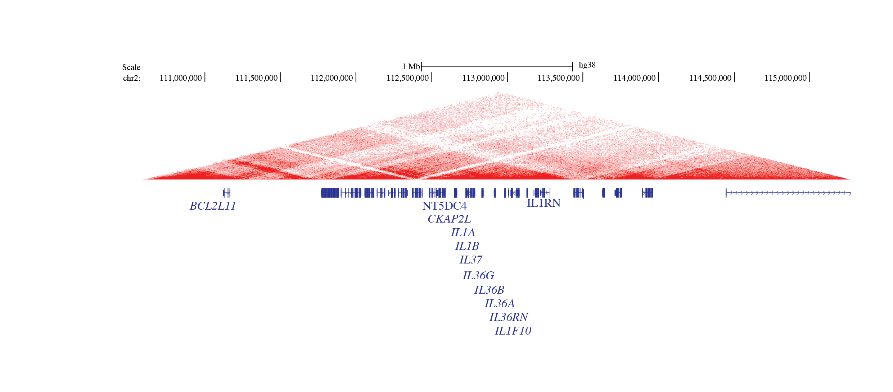
IL1 family members locate within a gene cluster and from one super TAD

Slide 49
IL-1RN is the critical brake for IL-1β
Patients with IL-1RN deficiency suffer autoimmune diseases.
The treatment is to give IL-1RN (ANAKINARA)
The principle behind is IL-1RN can inhibit the IL-1β-mediated inflammation as well as repivoting the Th17 to Treg program.
Notes:
An Autoinflammatory Disease with Deficiency of the Interleukin-1–Receptor Antagonist. New England Journal of Medicine 360, no. 23 (June 4, 2009): 2426–37. https://doi.org/10.1056/NEJMoa0807865.
Excess IL-1 Signaling Enhances the Development of Th17 Cells by Downregulating TGF-β–Induced Foxp3 Expression. The Journal of Immunology 192, no. 4 (February 15, 2014): 1449–58. https://doi.org/10.4049/jimmunol.1300387.

Slide 50
Optimized MNase usage (0.25ul – 0.5ul, 3.3E+6 cells)
Good percentage: 40-70%
0.25ul
0.375ul
0.5ul
63%
62%
68%

Slide 51
Time-course analysis does of LPS-stimulated monocytes not support the findings
IL1RN
IL1RN
IL1B
IL1B
22100.1
22100.1

Slide 52
The accumulation profile of active epigenetic markers (H3K4me3) in IL1RN and IL1B locus exhibit an opposite trend after stimulations with β-glucan and LPS for 6 days
Human monocytes, stimulated with β-glucan and LPS

